Slide 1
Finding the Science to support your Application
James Shaw & Ollie Bridle, Bodleian Libraries

Slide 2

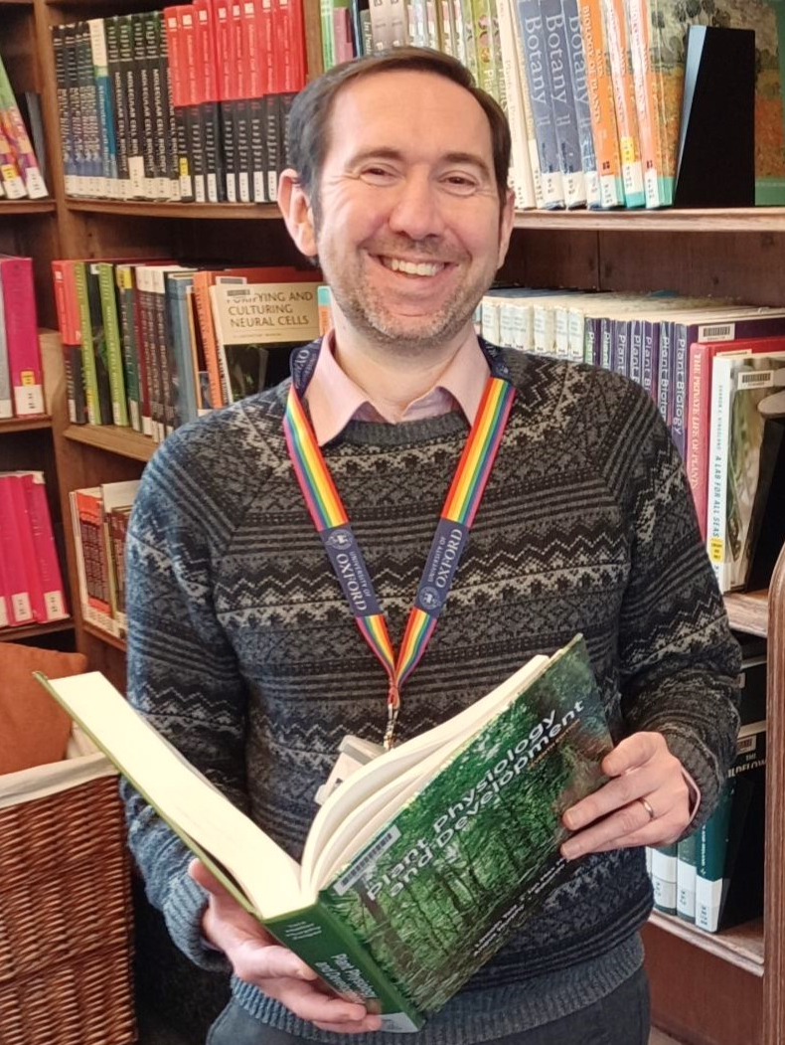

About us
Ollie Bridle, Life Science Librarian, Radcliffe Science Library
James Shaw, Academic Services Development Librarian, Bodleian Libraries
Notes:
Introductions

Slide 3

What we will cover
Finding free articles and books
Where to research your topic
Finding out about current research
Using other library services
Notes:
In this talk we will introduce you to some of the resources you can use to find scientific information for free on the web that you can use to support researching your application.
In particular we'll show you where to look for free, peer-reviewed book and scientific journal content.
Where to can research your topic using online literature databases.
How to find out about current research and the study areas of different researchers.
Making the most of public and local university library services that you may have access to.

Slide 4

Science for Free: open Access
In the past, access to published research often required a paid journal subscription.
Many scientific publications are now free to read.
These are often open access publications.
Anyone can download and read these publications without paying a fee.
Notes:
Over the last decade, more and more scientific research has become available to anybody for free.
In the past, you needed to have a membership to an organisation like a University that paid subscription fees for journals to be able to read articles.
Now, many researchers publish their articles open access, meaning that anybody can download and read their research.
This open research is still published in peer-reviewed scientific journals and has to adhere to the same quality standards as research put out by traditional research publications.

Slide 5

Finding Sources
Search for articles based on the topic or research question you're trying to answer.
Library catalogues allow searching for free e-books and open access journal articles.
Literature databases index scientific articles from thousands of journals.
Notes:
The scientific literature is vast!
The trick is to be able to pick out the content you want from everything that is available.
Library catalogues often cover not only physical collections but also books that are available electronically and journal articles. Most library catalogues are free to access over the web.
Literature databases allow you to search across thousands or even millions of papers from many different journals. They contain sophisticated search tools that allow you to create complex searches that can pin down research about specific topics.
Many literature databases are subscription only, but there are also free databases like PubMed available for anybody to use.

Slide 6
Using databases and catalogues
Search
Filter
Sort
Export
Use keywords related to your topic to find books and papers.
Restrict your results to free content, specific dates or languages.
Arrange your results by date or relevance.
Print, email or send records to a reference manager.
Notes:
Usually your search will start with some keywords related to topic you are trying to find information about.
Refine your results by just finding the latest articles, focusing on freely available open access content, or look at publications in different languages.
Sort your results to help highlight the most recent or relevant publications.
Export by printing records, E-mail or sending records to reference management software.

Slide 7



Journal Articles
Some journals publish only open-access content; others publish a mixture of subscription-only and open content.
DOAJ – Directory of Open Access Journals.
Browse journals by subject or search for specific articles.
PubMed – find biomedical and life sciences papers.
Search tools to identify specific information and filter by freely available content.
Notes:
Academic journals now often publish either in a fully open access format, or in a hybrid format including a mixture of open and paywalled articles.
The DOAJ indexes peer reviewed, academic journals that are all fully open access. You can browse journals by category or search for articles across the journals in DOAJ.
PubMed is a literature database that is particularly useful for find research in biomedical and life sciences research. It is free for anybody to access and indexes thousands of articles.
You can ask PubMed to filter your results so that you only see free, open access content making it easy to get access to research you can actually read in full.

Slide 8



Books
An increasing number of free and open access e-books are available.
DOAB – Directory of Open Access Books.
Thousands of peer-reviewed academic books, all free to read and download.
SOLO – Search Oxford Libraries Online.
Find free and open access books from a wide range of publishers.
Notes:
Many science books are now available online for free.
The DOAB includes thousands of peer reviewed books. You can browse by subject or search for specific titles.
SOLO is the University of Oxford's library catalogue. Although it catalogues the physical book collection which can only be accessed within libraries in Oxford, it also includes many free ebooks, including older, digitised material and more recent publications available open access from major academic publishers.
You can filter your results in SOLO to allow you to focus on just the free, electronically available books.

Slide 9
Beyond Articles
Preprints
Cutting-edge research
Theses
DPhil projects related to your topic
Often available in full-text
Recordings
Background information and context
Podcasts and Lectures
May not be peer-reviewed
Notes:
The academic literature you have access to is broader than just journal articles.
Preprints are 'draft' versions of research papers that scientists make available ahead of formal publications in journals. They are free to access and can give you a valuable insight into cutting edge research.
It's important to remember that pre-prints have not yet been through formal peer-review so reliability and accuracy can be an issue.
PrePrint servers on the web focus on different research areas like physics, earth sciences and biology.
Many DPhil Thesis are available in full text from University repositories. These can be great for getting an insight into the work already done on your or related topics.
Some universities make available free podcasts and lectures that can provide background and context to the research that is taking place.

Slide 10

Institutional research Repositories
Electronic access to papers, books, reports, research posters, and theses created by university staff and students.
Repository | Institution
ORA – Oxford University Research Archive | University of Oxford
RADAR – Research and Digital Assets Repository | Brookes University
ORO – Open Research Online | The Open University
Notes:
Most universities have online research repositories which act as a 'shop window' for research taking place at the institution.
You can often access free articles, book chapters, conference posters and datasets produced by researchers at the institution.
The table shows examples of different repositories available from the Universities involved in RePOWER.

Slide 11

Finding out about researchers' work
Use author searches in databases and catalogues to identify publications.
Researchers often maintain webpages describing their research interests and listing their publications.
Check institutional repositories and departmental websites.
Notes:
If you are researching your proposal, most researchers and departments maintain websites giving details of research interests and recent publications.
Many publications will be found in the institutional repositories just mentioned.
Most databases and catalogues will also allow you to perform an author search so you can track down publications by researchers you are interested in working with.

Slide 12
Using local Library services
Public Libraries
University Libraries
Access to Research – A public library scheme that allows access to online academic journals at your local library.
Interlibrary Loan and Document Supply - Obtain copies of articles or borrow books from larger libraries.
Walk-in Access – Use many e-books and journals while on campus.
Check – University policies vary considerably.
Notes:
Consider making use of you local libraries.
Many public libraries can allow you to access paywalled research publication through the Access to Research scheme. You can check on the Access to research website if your local library is included in the scheme.
Most public libraries will also offer an interlibrary loan scheme, although they may charge for this service.
If you have a local University, they may be able to offer walk-in access to both physical and some online resources.
Policies vary, so please check with your local University library.

Slide 13

Keeping on track
It's easy to lose track of what you've read.
Reference management software helps you -
  Record details of what you've read.
  Speed up citing the sources you've used as you write.
Zotero is a free reference manager that you can download from the web.
Many free presentations, videos, and handouts are available to teach you how to use Zotero.
Notes:
There are other free tools that can really help with your research as you identify literature to use to write your application.
Reference management software allows you to keep track of all the material you have been finding and reading and will help speed up your writing by automatically formatting your citations and reference lists as you write.
There are lots of different refence managers available, but a popular and well supported example is Zotero.
There are many free, online learning resources that will help you get started with Zotero.

Slide 14





Getting more help
Videos to go with this presentation.
A reading list of useful websites.
Online training materials.
Scan the QR code to access the reading list and videos.
Notes:
Hopefully this talk has given you some helpful ideas about where you can start your research, and shown how much scientific research you can access even outside a University!
To accompany this presentation, we have made a series of four videos that go into more detail about the online resources and services mentioned in this talk and demonstrate how to access and use them.
We have a reading list which includes links to all those videos and the different websites and database we've shown you today.
There are also training materials for Zotero which we have linked to in the reading list.
Scan the QR code to get started.

Slide 15

Thank you
Notes:
Thank you for listening and we wish you the best of luck in researching your applications!

