Slide 1

Funding a PhD or Masters
A Quick Guide
15th May 2026
Notes:
I'm Victoria Forth, the programme Manager for ILESLA.
Welcome to this short introduction on the financial aspect of undertaking a PhD or D.Phil. I will share these slides after the workshop (along with all the other presentations you’ve seen today) so don't worry if you don't manage to catch everything, or if you can't read any of the figures. I'm going to try and stick to time, so we can have some questions at the end, but if you need clarification on a point as I go along, please feel free to ask.

Slide 2
What are the costs of undertaking a research degree in the UK?
Fees – will vary between institutions £5,238 - £10,470 for home students up to £34,700 for international students.
Living costs – will vary with location – Indicative Oxford costs in table.
Research-related expenses (e.g. travel, consumables, computing) – will vary according to project
Notes:
We should consider the cost of doing a research degree in the uk up front. Fees/Living Costs/Research costs. These are elements that will generally be covered if you get a funded studentship offer from a programme like the ones here in the doctoral training centre, and they are government funded through the reseach councils. These types of studentships are available across the UK.

Slide 3
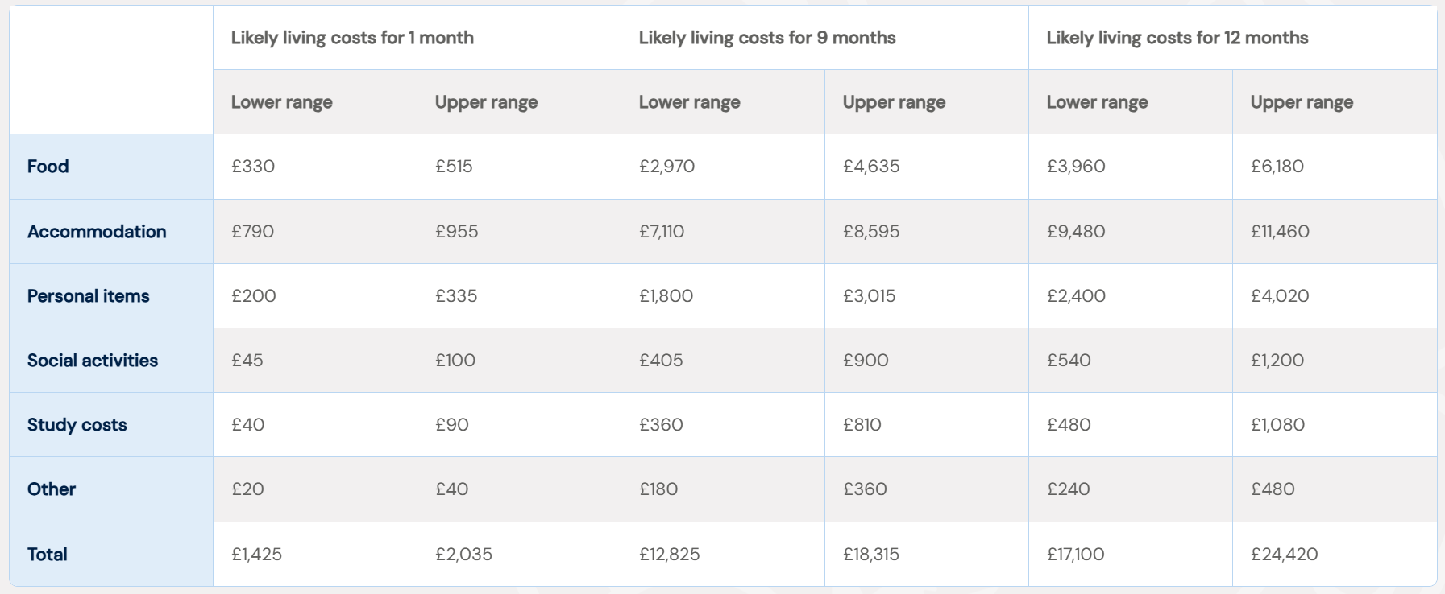
Indicative costs for Oxford
Notes:
It's important to work out what your living costs are likely to be. This table shows estimated costs for Oxford, but note that it doesn’t include elements like childcare which can really change the picture.

Slide 4
Additional costs for international students
Immigration Health Surcharge If you are coming to the UK for more than 6 months you will be required to pay the IHS, for yourself and any dependants. £776 per year or part of a year. Examples of costs are:
12-month Masters plus 4 months added by the Home Office to course end date; 1.5-year charge i.e. £1,164
DPhil courses at Oxford are set at 4 years maximum submission date plus 6 months to allow for viva and corrections and then 4 months added by the Home Office to the course end date; 5-year charge i.e. £3,880
visa, travel and relocation will depend on individual circumstances
https://www.gov.uk/apply-to-come-to-the-uk
Notes:
There are additional costs associated with being an international student wishing to relocate to the UK. The main one is the immigration health surcharge which is the same for a whole year, or part of a year. Most courses will add six months to the end of a course for the examination period so that adds an additional year of IHS to the costs. Then there is the visa itself, travel and relocation costs. This link on the Government website gives more detailed information about costs and the process of visa application.

Slide 5
Research costs
May be included with studentship/scholarship (e.g. UKRI)
May be covered by host research group or organisation
Small grants (e.g. scientific societies)
Choose a project that you and the supervisor can afford to do
Notes:
And then there are research costs. It’s important to consider research costs and discuss with potential supervisors, as some will have other sources of funding such as research grants which could help fund these. Consider these when you are designing your project. Don't choose a project that requires £40K of DNA sampling if your supervisor isn't able to contribute anything to that cost.

Slide 6
How can you meet these costs?
Notes:
I'm going to suggest a few routes to getting funding for a PhD or Masters now, but there are so many pots of money about that it wouldn't be possible to create an exhaustive list but these are my top five suggestions.

Slide 7


UK Research and Innovation (UKRI)
https://www.ukri.org/what-we-do/developing-people-and-skills/bbsrc/doctoral-training/
https://www.ukri.org/what-we-do/developing-people-and-skills/nerc/nerc-studentships/responsive-training/
Notes:
If you are considering a PhD then the primary funders in the UK are the Research Councils, funded by the UK government. They award funding to universities to deliver training programmes which aim to create cohorts of students who are mutually supported, and supportive. To get this funding you apply direct to the institutions, to the individual programmes of study. There are a lot of them, so visiting the UKRI website is a good way to find out which universities have been granted funding and what the different funded programmes are called, and you can then go on to research the individual programmes themselves to find the ones more suitable for you.
These programmes will typically pay the course fee on your behalf, plus provide you with a tax-free living grant (aka stipend) and a research and training support grant (RTSG) of between £7K and £20K dependant on the programme of study.
There will be differences in how different programmes of study manage their studentships, some may ring-fence funding for particular under-represented groups, or particular supervisors or areas of study. Some will recruit direct to projects, others will award funding to students and allow them to choose/develop project later. It’s worth doing your research on how the funding is allocated.
There is funding for international students, UKRI caps this at 30% of student numbers funded from the UKRI grant so it is limited, and extremely competitive.

Slide 8
2. Bursaries and Scholarships
May wholly or partially cover fees and stipend for Masters and Doctoral degrees
Institution-specific awards
Diamond Light Source, https://www.diamond.ac.uk/Careers/Students/PhD-Studentships.html
Pirbright - https://www.pirbright.ac.uk/careers-and-learning/education-programme/postgraduate-studentships
university-linked scholarships (check institutional websites)
Independent charitable trusts
e.g. Rhodes - https://www.rhodeshouse.ox.ac.uk/scholarships/the-rhodes-scholarship/
https://www.findaphd.com/guides/phd-study-in-uk/charities-funding
Government Visit governmental websites
Commonwealth scholarships https://cscuk.fcdo.gov.uk/about-us/scholarships/
United Nations (IPCC, UNESCO) https://www.un.org/ldcportal/content/scholarships
International scholarships
Notes:
May wholly or partially cover fees and stipend for Masters and Doctoral degrees. There is a wealth of funding available and it can be hard to know how to find it.
Many institutions and organisations support PhD students, for example Diamond Light Source and Pirbright who do this quite separately from the ILESLA programme. BGS, CEH and many other research organisations offer PhD opportunities so if there is an organisation you would like to work with it’s worth googling their name and PhD studentships.
Some organisations, and even some charitable trusts, for example Rhodes, will cover additional costs such as flights and the NHS surcharge for international students but this is not always the case. Rhodes does have an upper age limit of 27 however but findaphd has a database of charities that provide PhD funding full or partial
You might find it useful, if you are an international student, to research grants and scholarships from your own government. Canada, for example, does offer funding for students to study abroad through their own research councils. The IPCC (international panel for climate change), and UNESCO offer funding to students from developing countries.
For many bursaries and scholarships there are restrictions, many are linked to e.g. nationality, protected characteristics such as ethnicity, gender or disability. Some international scholarships will require students to return to their home country within a certain time after completing the degree.

Slide 9
3. Employer Funding
Oxford University Staff can get help towards the cost of fees
https://academic.admin.ox.ac.uk/fees-and-continuation-charges/university-staff-awards
Current employer sponsorship
Industrial Sponsorship – student-led
Industrial Sponsorship – supervisor-led
Notes:
Some institutions will have staff benefits in place such as reduced fees, or complete fee waivers. So one way of doing a funded PhD is to start by getting employment within a research group as a lab assistant or technician. More on that in the next slide.
Some employers will fund employees to do doctoral research as part of their professional development. The Armed Forces are a particularly good example of this. We are able to contribute course fees to studentships where an employer continues to pay a salary throughout the PhD.
There are many different models of industrial sponsorship from the minimum CASE contribution required by NERC (£1K per year) up to coverage of the full studentship.
Some students who have connections with industry have been highly effective in negotiating 50/50 awards.
Sometimes the supervisors manage to get partial or full awards through their industrial connections, or even their links with/grants from learned societies such as the Royal Society.

Slide 10
4. Grants and supervisor/project-linked funding
Funding may be provided through research grants awarded to individual supervisors or teams of supervisors by organisations that allow studentships to be costed into grants. e.g. Leverhulme Trust, Royal Society, BGS, even individual donors.
Supervisors can also apply for studentships to address a specific research topic - e.g. Marie Sklodowska-Curie Actions
Some supervisors have access to funding to support students - very rare in the UK – if funding exists it will usually be advertised
Notes:
It’s always worth discussing with a potential supervisor, especially where they are an established leader in the field, if they have funding available through their own research grants, or through a charitable donor. If applying to Oxford there are college held bequest scholarships that may be linked to fellows in certain departments studying certain topics so don’t be afraid to ask the question.
Part of being a PI is constant applications for funding, and they will almost always include a costing for one or more PhD students, if that’s allowed.

Slide 11
5. Student Loans
Masters: An overview of Postgraduate Master's Loans and details of how to apply is available from your regional funding agency's website
Doctoral: Doctoral The English and Welsh governments introduced a loan scheme for doctoral courses from 2018/19 entry.
England: https://www.gov.uk/doctoral-loan
Wales: https://www.studentfinancewales.co.uk/postgraduate-finance/doctoral/
Scotland and Northern Ireland are the same links as for Masters programmes.
US Federal loans for students from the USA https://www.ox.ac.uk/admissions/graduate/fees-and-funding/loans/us-loans
Student Finance England https://www.gov.uk/masters-loan
Student Finance Wales https://www.studentfinancewales.co.uk/postgraduate-finance/master-s/
Student Awards Agency for Scotland https://www.saas.gov.uk/full-time/postgraduates
Student Finance Northern Ireland https://www.studentfinanceni.co.uk/types-of-finance/postgraduate/
Notes:
It’s of course preferable not to have to take out a loan in order to do a PhD, but if you do then doing so through a government route is the best way to do it. The UK government scheme requires that you only have to pay back the loan once your income reaches a certain threshold, this is agreed in advance as your “repayment plan”

Slide 12

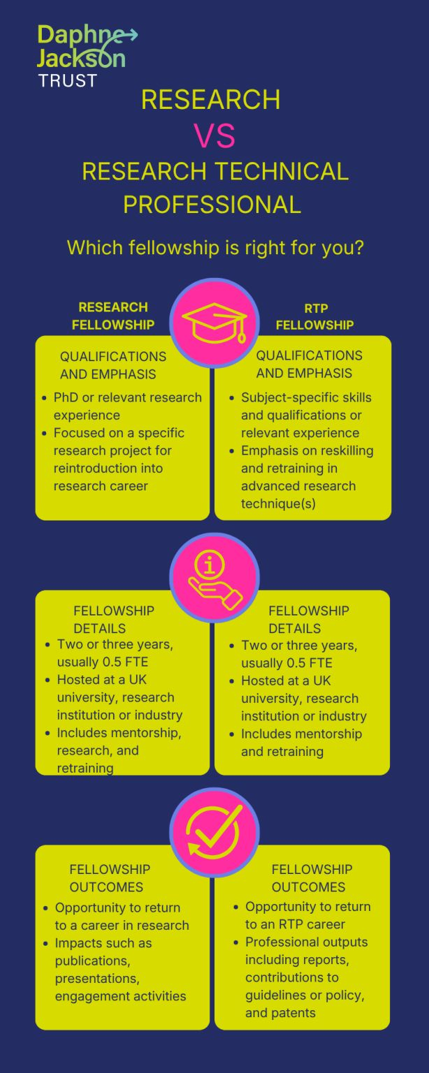
Daphne Jackson Trust
If you've taken a career break of at least two years for family, caring, or health reasons and are ready to return, the Daphne Jackson Trust could help you restart your career with confidence.
We offer two types of fellowships:
🔬 Research Fellowships – for those returning to active research
🛠️ Research Technical Professional Fellowships – for those in specialist technical roles
Each fellowship is fully supported and tailored to help you rebuild skills, confidence, and networks in a flexible, supportive environment.
💡 Ready to find out which one is right for you?
https://daphnejackson.org/apply/types-of-fellowship/
Notes:
The Daphne Jackson Trust does not offer funding, but it does connect fellows with research opportunities that do.
This is a post on linkedIn which advertises the Trust and gives the essential information on the fellowships available. Some of these lead into funded PhD opportunities, others into more professional roles that can re-skill and retrain.
Fellowships usually take place in UK universities, research institutions or industry, and they include mentorship and retraining. They are a great way of creating networks and contacts within your area of interest which can shore up later applications either for employment or for study.

Slide 13
General points to consider
In the UK postgraduate students are not normally considered to be employees - Affects tax status and benefits
No pension contribution unless students set this up independently
Working while studying – difficult to support yourself through work while studying full-time (UKRI guidance <6 hours per week on average)
Visas for international students may not permit work or restrict the number of hours a student can work
Although you may only need to provide proof that you can support yourself for 1 year to be admitted – you will need to support yourself for the full course of study
Not normally possible to secure a scholarship or funding from a host institution after commencing study
Notes:
The first point does mean that you are not liable to pay tax in the UK, on your stipend, although students from the US may need to file a tax return with the IRS. The downside is you don’t then pay into National Insurance or pensions.
It’s not recommended to work more than 6 hours, if studying full-time. University regulations may state up to 20 but this is unrealistic and would be disadvantageous. And of course you do need to check the conditions of your visa if you are international. Most scholarships are awarded in year 1, and are much harder to find in year 2 onwards. You do need to be able to support yourself for the full duration of the course.

Slide 14
Questions?

