Slide 1






RePOWER: Returning to postgraduate study

Slide 2



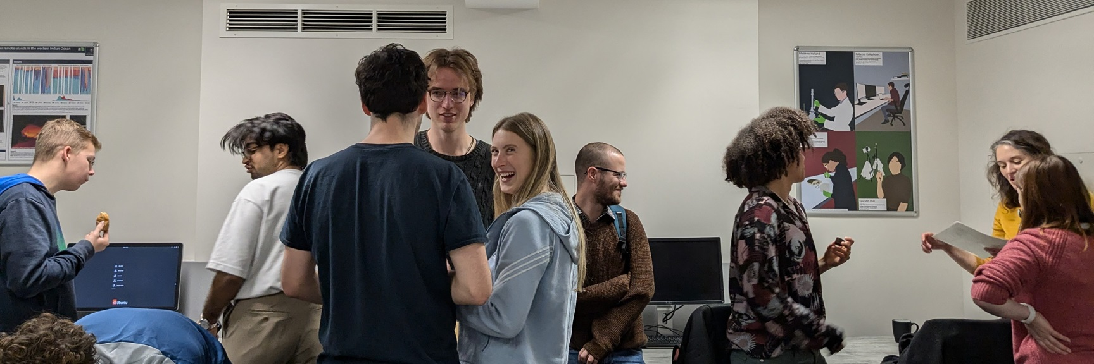


Welcome to the Doctoral Training Centre
Supporting scientific breakthroughs
Developing new skills and interdisciplinary collaborations
Underpinning industrial innovation
Equity, equality, diversity, inclusion and societal impact
Community, collaboration and kindness
ENAIBLE

Slide 3
Schedule
am
pm
Applying to postgraduate study
Returning to postgraduate study
1.45-2.15 Childcare, parental leave and carer’s leave
2.15-2.30 Modes of study & time management
2.30-2.45 Finance
2.45-3.00 Disability, neurodivergence and wellbeing
3.00-3.15 Transitioning to postgraduate study
3.15-3.30 Q&A
3.30-4.00 Discussion
4.00-4.30 General Q&A
College visits
Networking and buffet – Royal Oak Pub 42-44 Woodstock Rd, Oxford OX2 6HT
10.00-10.30 Registration
10.30-11.00 Introduction to postgraduate study
11-11.15 Making the decision to apply
11.15-11.30 Q&A
11.30-11.45 Break
11.45-12.15 Applying to postgraduate study
12.15-12.30 Accessing information and publications
12.30-12.45 The application process
12.45-1.00 Q&A

Slide 4
Introduction to postgraduate study

Slide 5

Why do a PhD/Masters?
Good reasons to do a postgraduate degree
Thirst for knowledge
Desire to make an impact through research
Enjoy learning and problem-solving
Increase employability and earning potential in academia and fields requiring analytical, communication and quantitative skills
Career pivot or specialisation
Build connections
Develop skills such as organisation, self-motivation and independent planning and project management

Slide 6
Types of postgraduate study
Bachelor’s Degree
3 years
Integrated Masters - 1 year
Usually involves taught and assessed modules – often part-time.
Assessed by coursework and/or examinations
Can involve taught modules – usually involves research (Masters dissertation)
Assessed by coursework, examinations or dissertation as appropriate
Postgraduate Certificate
6 months
Masters (Taught)
9 months - 2 years
Postgraduate Diploma
1-2 years
Masters (Research)
1-3 years
Doctorate (PhD/DPhil)
2+ years
Continuing Professional Development
Assessed by dissertation and viva
Doctorate by publication
Professional Doctorate
Combinations: e.g. 1+1 Joint Masters 1+3 Masters and Doctorate

Slide 7
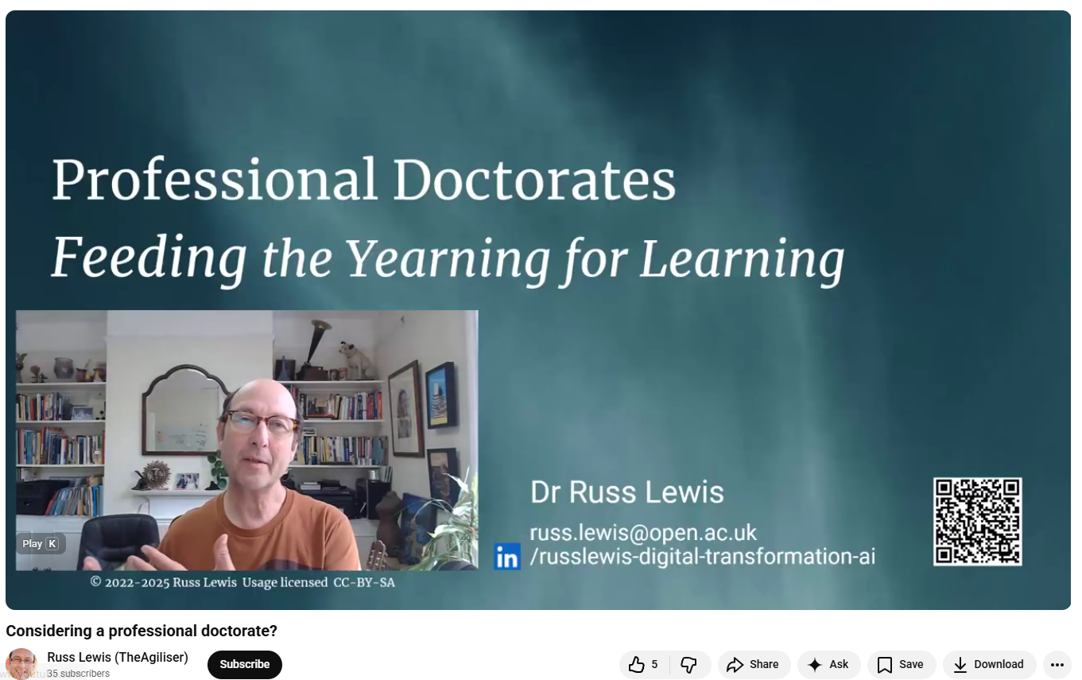
Professional Doctorates
https://youtu.be/RxIo9Tu276w

Slide 8

Training knowledge workers…
PGCert – 5K
PGDip – 10K
Masters – Half marathon
Doctorate – Full marathon

Slide 9
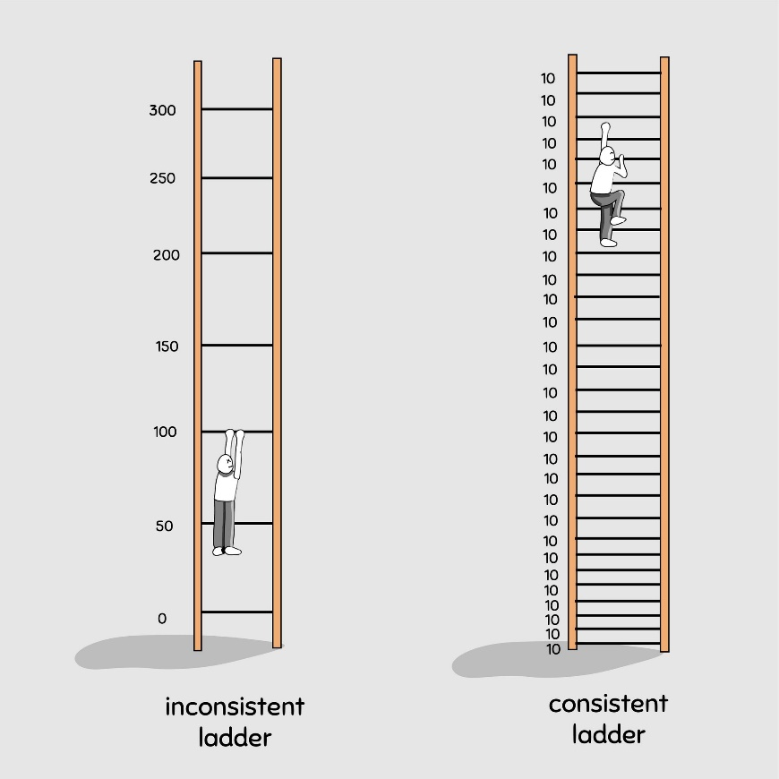
David Perell, Learn Like an Athlete, 2019
“Knowledge workers should train, and implement strict “learning plans.”
… there’s a lot to learn from the way top athletes train. They are clear in their objectives and deliberate in their pursuit of improvement.”

Slide 10









Benefits of research degrees…
Knowledge
Critical thinking
Networking
Time management
Data analysis
Communication
Career opportunities
Competitive job application
Teamwork

Slide 11
Research degrees (Masters and Doctorate)
Typical dissertation…
Literature / prior work
Aims and Rationale
Results
  Method development
  Data collection
  Data analysis
  Model development
  Tool development…
Interpretation/critical analysis
Context, implications, further work
Dissertation based on your research
Can include research undertaken within a team
Supervisor(s)
Assessment by dissertation and viva

Slide 12
Responsibilities of supervisors…
Regular meetings (Oxford – at least once every two weeks for a full-time student)
Agree a research plan and programme of work
Clear academic expectations and milestones.
Agree a timetable for submission of work and provide feedback on work
Advise students on health and safety regulations.
Assess and advise on subject-specific and professional development training
Ensure students have a plan of how they are going to move ahead
Report on student’s progress and needs

Slide 13




Mentoring modes…
Challenger
Focus
Goal-oriented
Achieving
Cheerleader
Optimistic
Supportive
Encouraging
Educator
Learning
Training
Developing
Ideator
Brainstorming
Planning
Empowering

Slide 14


Mentoring styles - interactions

Slide 15
Supervisory teams and mentors
It is common – and often required – for students to have a supervisory team (2 or more supervisors)
One supervisor will be the “primary” supervisor
Students may have a day-to-day research mentor who is a more experienced researcher within their research group
Students often have an additional mentor or advisor who is not involved in their supervision, who they can go to for pastoral advice
All students within a Department or Programme are also supported by a Director of Graduate studies and/or Programme Director

Slide 16
Assessment - Doctorate
5K
Research proposal*
First examination (at Oxford called “transfer of status”)
  Good evidence of progress, knowledge of subject, feasible project and plan
10K
Half
Second examination (at Oxford called “confirmation of status”)
  Good evidence of progress, knowledge of subject, feasible plan to complete project
Final examination – Doctoral viva
Full
*Depends on programme

Slide 17
Doctoral / Masters viva
The candidate is the true author of the thesis
The candidate possesses a good knowledge of the field of learning within which the subject of the thesis falls
  the candidate has shown competence in investigating the chosen topic
The candidate has made a significant and substantial contribution in the field of learning within which the subject of the thesis falls
  the candidate has made a worthwhile contribution to knowledge and understanding in the field of learning within which the subject of the thesis falls
The thesis is presented in a lucid and scholarly manner
The thesis merits the degree

Slide 18
Doctorate by publication (some UK universities)
Apply to be accepted as a student based on your published work
6 months – 1 year
Supervisor(s) provide advice on developing a narrative to frame your published work and preparing for the viva
Doctoral viva addresses the same criteria as a standard doctorate

Slide 19
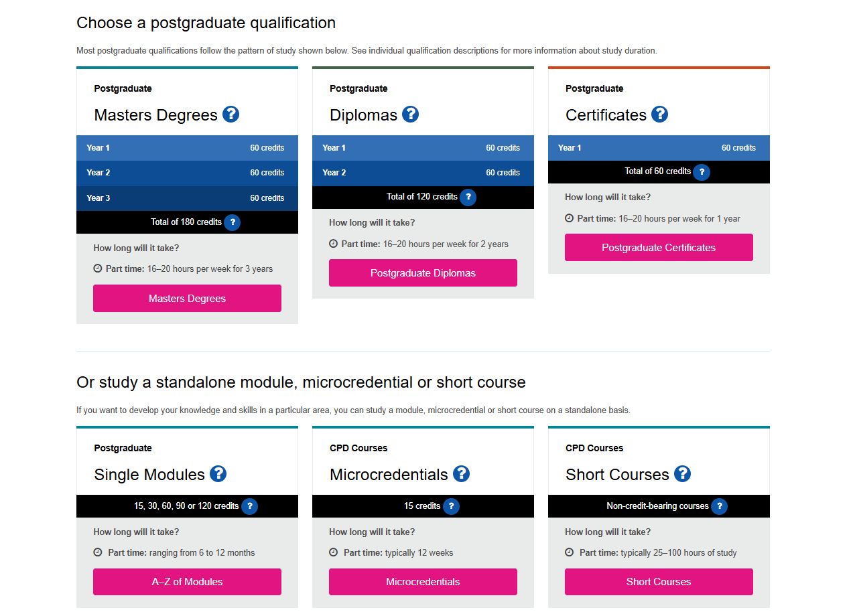
Single modules, microcredentials, short courses and continuing professional development
Postgraduate Course Types | The Open University

Slide 20
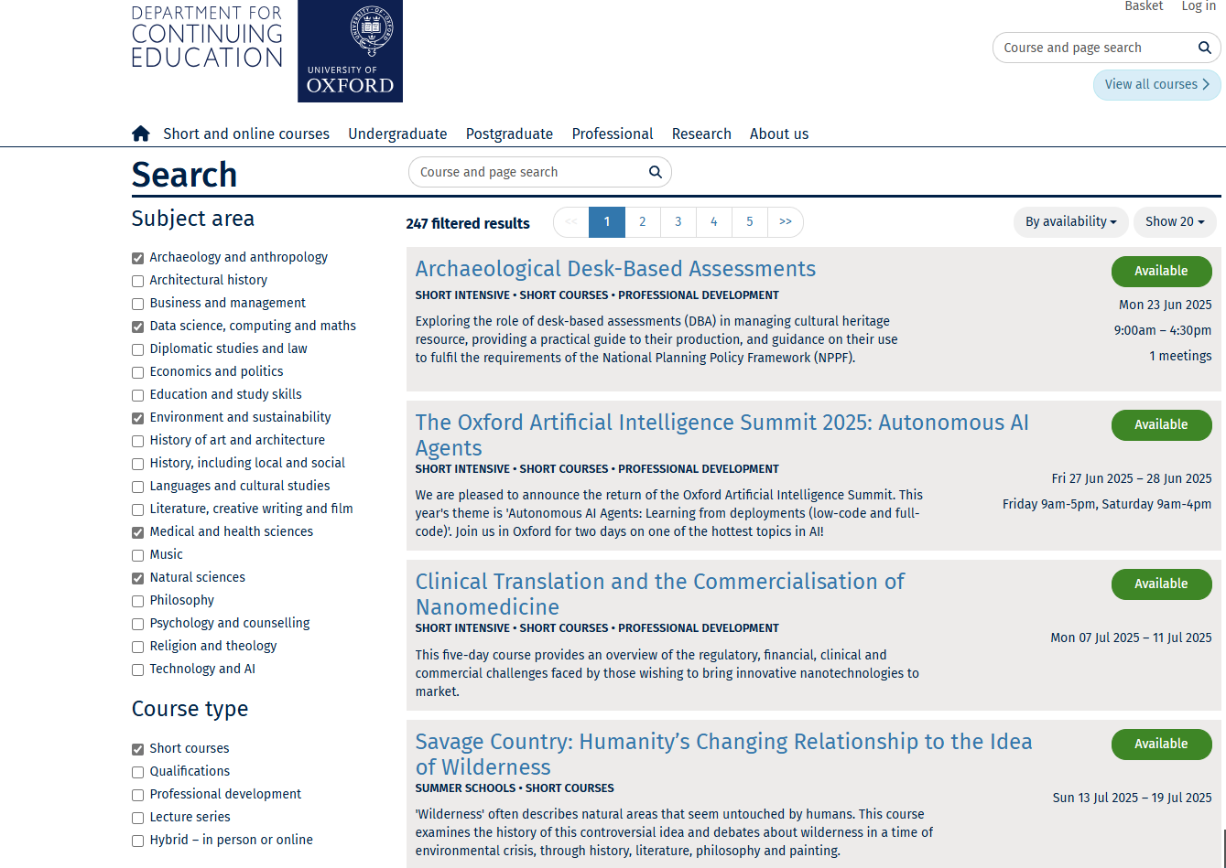

Slide 21
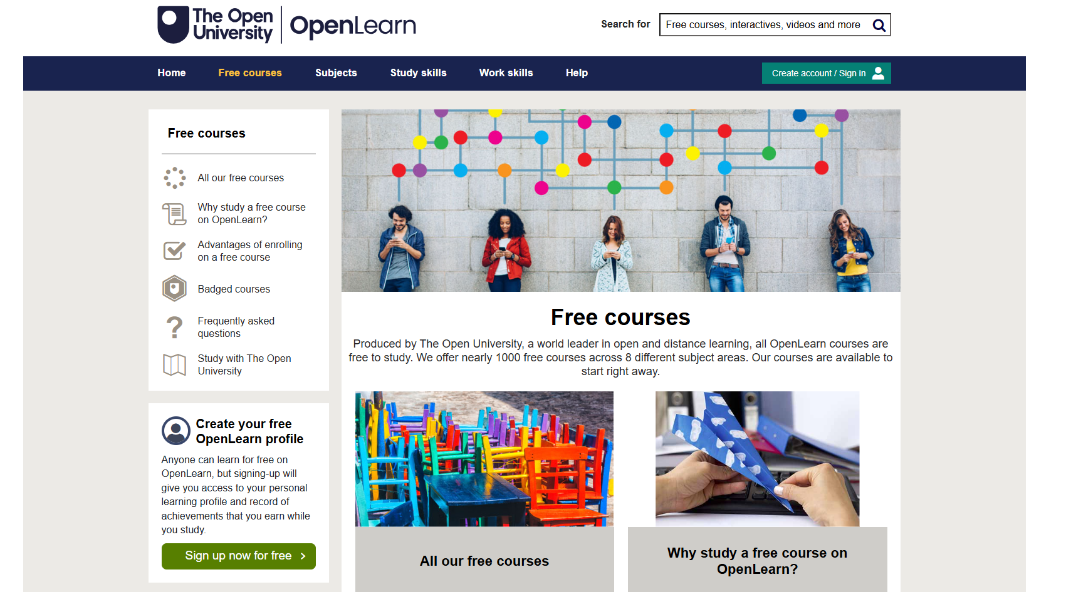

Slide 22
Origins of research projects
Supervisor(s)
Non-academic partner
Student
Often subject to funding model…

Slide 23
Research projects involving non-academic partners
May be undertaken wholly or partially in an academic or non-academic setting (subject to agreement by the University and funder)
May be undertaken full or part-time by employees
A period of residency with the academic or non-academic partner may apply
Usually require a contract between the partner organisations addressing intellectual property and responsibilities
Sometimes provide additional financial / project support
Often have direct impact for the sponsoring partner or sector
Held build students’ professional networks and skills

Slide 24
Enterprise, Innovation & Impact
Some projects may have translational potential & broader impact
  Commercial – e.g. spin-outs, start-ups, licencing…
  Policy
  Practice
  Tools, collections and resources
If you want to bring data or IP to a project from previous work it is important that it is with the consent of the rights holders and initially discussed under a non-disclosure agreement until an appropriate contract is in place

Slide 25
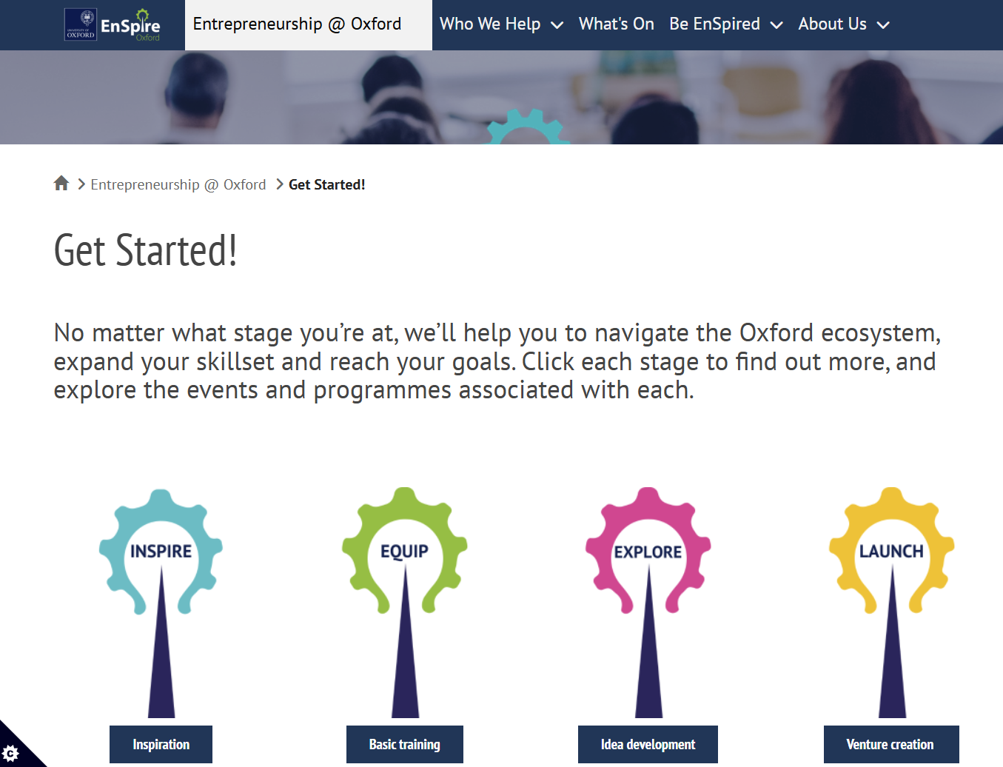


Studying for a degree can open up opportunities for further training and support in entrepreneurship, policy and professional skills

Slide 26
Technology transfer
In many cases your university will have a claim to ownership of IP developed directly in the course of your degree study or your work for the university
Universities vary in arrangements for developing IP and the share retained by the university and the inventors
Most universities have arrangements with technology transfer companies or internal technology transfer offices that help researchers develop, patent and commercialise their research

Slide 27
Internships and Placements
Some doctoral programmes have compulsory internships/placements
Most programmes allow students to optionally undertake placements & research visits to other institutions
Placements may help to further develop your skills, networks and employability

Slide 28
Taught courses for doctoral students
Offered by many doctoral programmes
Integrated (4 years) or Masters/PhD (1+3 years)
Provide discipline/subject area specific skills and knowledge
Vary widely by programme (3 weeks – 12 months)

Slide 29
ILESLA Year 1
DPhil topic confirmed
Induction
Introducing ILESLA
Cohort Building
Visits to Partner Organisations
Supervisor/partner networking
Project Presentation
Project Presentation
Project Write-Up
Project Write-Up
First Rotation
Second Rotation
Project Proposal & Viva
Induction
Core Skills Training
Team project
Additional Training / Doctoral Landscape Training Network
Team project
Research Skills/Career Development Training
Michaelmas Term (Oct-Dec)
Hilary Term (Jan-Mar)
Trinity Term (Apr-Jun/Jul)
Internship Event
ILESLA Networking Event(s)
ILESLA Annual Symposium

Slide 30
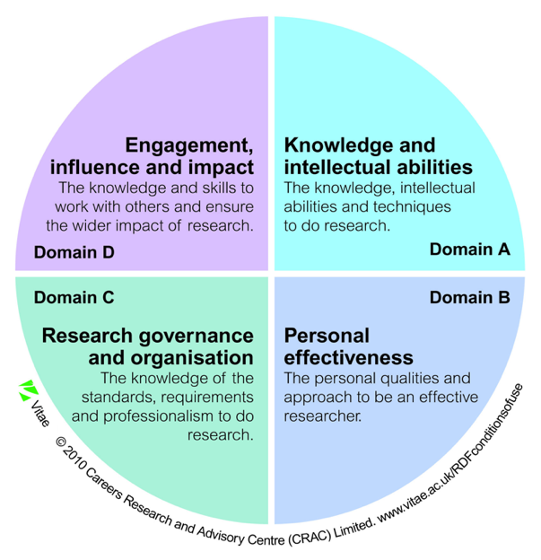
Examples of Professional Skills Courses
Preparation for Learning and Teaching at Oxford
Presentation Skills and Scientific Writing
Introduction to Innovation and Impact
Scientific Methodology
Public Engagement Workshops
HTML and Webpage Design
Science Communication Workshops
Producing a scientific poster
Enterprise and Entrepreneurship
Creative Thinking
Research Ethics
Managing your Supervisor
Careers Overview
Project Management
Interview Techniques
‘How to do Research’ Sessions
CV Writing
The Role of Science in Policy
Planning to write your DPhil
Notes:
Alongside the research training, we offer a comprehensive professional skills programme that will help you to develop into a rounded researcher.
Professional skills training aligns well with the 4 domains of Vitae’s Researcher Development Framework that describes the knowledge, behaviour, and attributes of successful researchers.

Slide 31
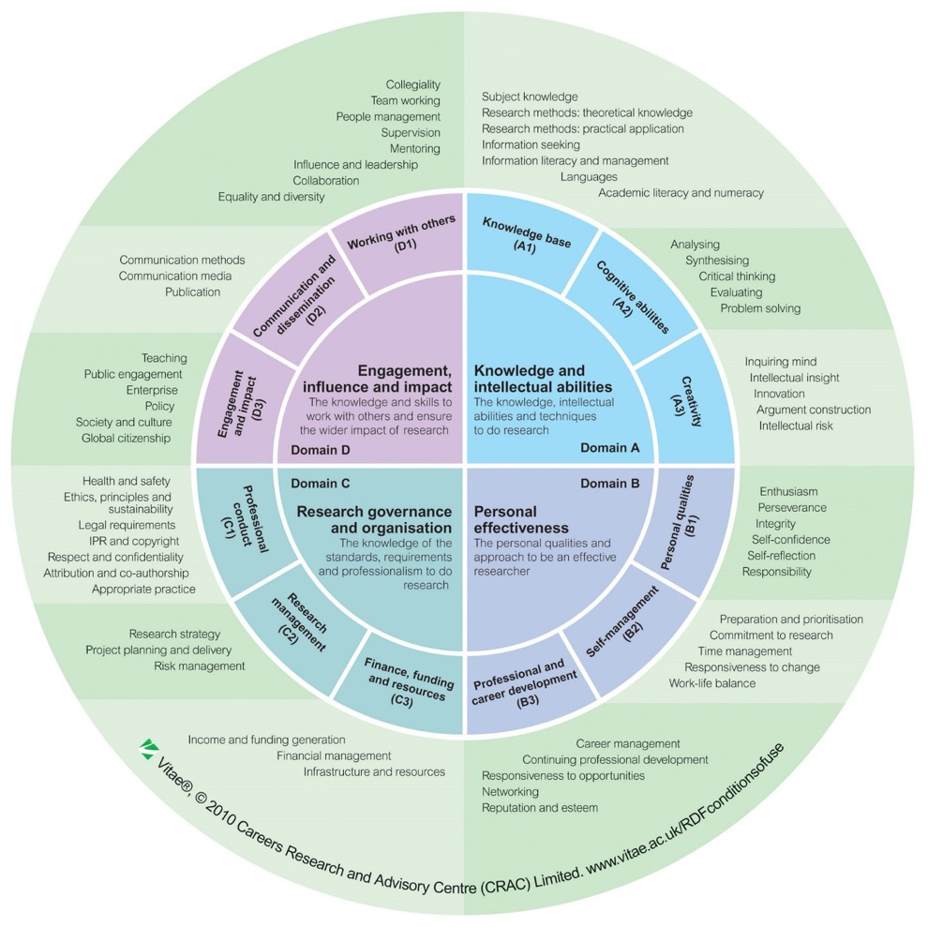
Vitae Research Development Framework (RDF)
describes the knowledge, behavior and attributes of successful researchers
www.vitae.ac.uk
Notes:
Being a successful scientist does not just mean having the practical skills to carry out your experiments and analyses, but it includes a variety of knowledge, behaviours and attributes. These are very nicely illustrated here in the Vitae Research Development Framework and include four domains….
The RDF is a very helpful tool to explore all aspects of being a researcher and to identify areas where you might have some gaps and need to develop your skills further.
Vitae: professional non-profit programme supported by UKRI and universities that leads on career development of researchers

Slide 32
Demonstrable skills for employability
Critical thinking and analysis skills
Problem solving skills (including knowing when and how to seek assistance)
Motivation, commitment and resilience
Time and project management
Communication skills
Interpersonal, team and leadership skills
Specific technical skills/academic background knowledge (depends on the job)
Broad knowledge of your discipline and other disciplines (flexibility and adaptability)

Slide 33



Career Development
All academic institutions have careers service staff to provide guidance and advice to students and promote jobs and career development opportunities
Students benefit from having a career development plan that they discuss regularly with a mentor

Slide 34


Community and networks
Students are usually part of a cohort within their course, department or programme
Studying for a degree provides extensive opportunities to develop your network through courses, collaborations, seminars & societies (and at universities such as Oxford - colleges)
Universities have communities of researchers across all life-stages – with a common love of learning
Some provide specific social opportunities for older or returning students – and their family members

Slide 35

Recognising and supporting diversity in all its forms is core to promoting belonging and wellbeing
https://diversityjournal.com/24678-diversity-includes-disability/

Slide 36
Schedule
am
pm
Applying to postgraduate study
Returning to postgraduate study
1.45-2.15 Childcare, parental leave and carer’s leave
2.15-2.30 Modes of study & time management
2.30-2.45 Finance
2.45-3.00 Disability, neurodivergence and wellbeing
3.00-3.15 Transitioning to postgraduate study
3.15-3.30 Q&A
3.30-4.00 Discussion
4.00-4.30 General Q&A
College visits
Networking and buffet – Royal Oak Pub 42-44 Woodstock Rd, Oxford OX2 6HT
10.00-10.30 Registration
10.30-11.00 Introduction to postgraduate study
11-11.15 Making the decision to apply
11.15-11.30 Q&A
11.30-11.45 Break
11.45-12.15 Applying to postgraduate study
12.15-12.30 Accessing information and publications
12.30-12.45 The application process
12.45-1.00 Q&A

Slide 37
Making the decision to apply

Slide 38
Break

Slide 39
Parental leave and carers

Slide 40

Being a student parent
Oxford Student Union estimates there are over 350 student parents at the University of Oxford – mainly postgraduates
Over 50 students give birth each year
Nationally it is estimated that 8% full-time and 36% part-time students domiciled in England are parents
https://www.oxfordsu.org/resources/0/Student-Parents/
Towards the family friendly university? Research evidence on student parents and implications for higher education policies | Advance HE

Slide 41
Parental leave and support policies (Oxford)
Any student regardless of how they are funded, is entitled to take time off from their study if they become a parent
Pregnant students are permitted leave to attend antenatal and medical appointments and have a student support plan drawn up with their department
The student who gives birth to the child is eligible to take maternity leave while their partner is eligible to take paternity leave
The student who gives birth can suspend their studies to take up to a year of leave
Postgraduate research students on maternity leave are permitted a maximum of 10 ‘Keeping in Touch’ (KIT) days across the maternity leave period to participate in activities related to their research project
Departments will provide access to breastfeeding space

Slide 42
Parental leave and support policies (Oxford) cont.
Depending on their visa, overseas students who suspend their status may be required to return to their home countries while suspending their studies to take parental leave
Depending on their funder, students may be able to access funded leave
  – e.g. UKRI: The first 26 weeks would normally be paid at full stipend, the following 13 weeks at a level commensurate with statutory maternity pay and the final 13 weeks unpaid
Student fathers are permitted leave to attend antenatal and medical appointments and may take up to 2 weeks’ (10 working days) ordinary paternity leave
Student fathers who are eligible for additional leave from their funder may request up to one year of leave

Slide 43
Adoption leave
  Arrangements for adoption leave usually parallel those made for maternity and paternity leave, in that the main carer takes ‘maternity leave’, regardless of sex, and the carer’s partner takes ‘paternity’ leave.
Policies and eligibility may vary between institutions: Check the policies for the institution and funding you are applying to

Slide 44
Studying for a postgraduate degree as a parent…
Working/studying hours - How much and how flexible?
Working from home - Is it possible to study, work or meet online or to access recorded content?
Unplanned absences – What contingency arrangements can you put in place for research or study to support unplanned absences?
Childcare costs - What are these likely to be?
Travel - How long will it take to get to and from your institution or place of work?
Placements - When are these likely to happen and how will they impact on your childcare arrangements? Are there any alternatives to an in person placement?
Conferences – What arrangements are needed if you wish to attend a conference or evening events? Can you attend remotely? Is support with childcare available from the conference or funders?

Slide 45
Carer’s leave (UKRI)
Some institutions offer specific support to individuals with caring responsibilities
UKRI regulations state that a stipend of up to 5 days per year pro rata may be drawn by a student who needs to give or arrange care for a dependant with a long-term care need.
This is defined as a dependant with a disability under the Equality Act 2010 (or DDA in Northern Ireland), care need related to old age, or an illness or injury likely to need care for more than 3 months. The studentship may be extended to account for periods taken as carers leave.
Funders and scientific societies may also offer support for carers to participate in events and conferences

Slide 46
Schedule
am
pm
Applying to postgraduate study
Returning to postgraduate study
1.45-2.15 Childcare, parental leave and carer’s leave
2.15-2.30 Modes of study & time management
2.30-2.45 Finance
2.45-3.00 Disability, neurodivergence and wellbeing
3.00-3.15 Transitioning to postgraduate study
3.15-3.30 Q&A
3.30-4.00 Discussion
4.00-4.30 General Q&A
College visits
Networking and buffet – Royal Oak Pub 42-44 Woodstock Rd, Oxford OX2 6HT
10.00-10.30 Registration
10.30-11.00 Introduction to postgraduate study
11-11.15 Making the decision to apply
11.15-11.30 Q&A
11.30-11.45 Break
11.45-12.15 Applying to postgraduate study
12.15-12.30 Accessing information and publications
12.30-12.45 The application process
12.45-1.00 Q&A

Slide 47
Modes of study

Slide 48
Modes of study - time
Full-time - commitment to study is above six or seven hours per day, qualify as soon as possible, cannot continue full-time work
Part-time – may be restricted to 50% or more. Some postgraduate taught degrees are specifically designed for part-time study
If studying for a research degree it is possible to switch between modes of study, depending on funder/university regulations and approval

Slide 49
Modes of study – engagement and location
In person study/research – requires proximity to your place of work/study
For research degrees the institutions at which you undertake research can include institutes and industry as well as universities, and your degree may include periods of field work
Some universities have residency requirements (duration/distance) – although these can sometimes be waived when justified
Blended learning – mixture of in person and remote
Distance learning – entirely or mostly remote
Block mode learning – full-time for limited periods

Slide 50
Specific study-related commitments to consider
Supervisor meetings
Research group meetings
Research seminars
Training courses
Conferences
Assessments and examinations
Laboratory research or fieldwork (if relevant)

Slide 51
Part-time research degrees
Topic and approach may need to be tailored accordingly
Questions and methodologies may need to evolve over time
May be limited to supervisors with permanent / long-term contracts
Submission deadline is a limit – not a target – you can submit early – e.g. at Oxford you can submit a doctoral thesis in 6 terms (2 years)
Check funder supports part-time study
Discuss arrangements with supervisor before committing

Slide 52
Interruptions
Most courses will allow for a certain amount of planned or unplanned interruptions to full or part-time study due to medical leave, parental leave or short-term opportunities – e.g. placements
Some funders provide paid medical leave for extended periods of illness or to provide additional support for disabled students
Some funders provide compassionate leave
It may be possible to make a phased return from a period of leave

Slide 53
Working hours
Taught courses may have scheduled lectures and tutorials – so students may need to work within a fixed schedule
Research degrees will have training and seminars – but the timing of working hours may be much more flexible

Slide 54
Example policy: Working hours and holidays
Doctoral students should work conscientiously during their working hours in order to achieve their research objectives.
It is recommended that students aim to work a regular pattern that balances their preferences, research needs and flow of work, and that they take regular breaks and holidays.
Consistently long working hours with few breaks and insufficient holidays is detrimental to health and reduces productivity, creativity and innovation.
https://www.mpls.ox.ac.uk/graduate-school/information-for-postgraduate-research-students/your-rights-and-responsibilities

Slide 55
Example policy: Working hours and holidays
The standard DPhil working week is set at an average of 40 hours. Only time spent engaged in focused, conscientious work should be counted towards working hours.
The maximum number of hours that a student should be working is an average of 48 hours over 17 weeks.
It is recognised that sometimes long working hours are needed for a period to manage the demands of the research, but no student should be regularly working above this number of hours unless they have explicitly and freely chosen to do so.
The university has set the holiday entitlement at 30 personal days a year in addition to Bank Holidays. Where Bank Holidays are worked time can be taken in lieu.
https://www.mpls.ox.ac.uk/graduate-school/information-for-postgraduate-research-students/your-rights-and-responsibilities

Slide 56
Additional considerations
Other considerations
Building networks and interacting with co-workers
Professional skills and broadening activities (norm of 100 hours per year)
Sport and health
Access to equipment/resources
Culture/religion
Disability
Medical leave
Maternity, paternity and adoption leave
Caring
Compassionate leave
https://www.mpls.ox.ac.uk/graduate-school/information-for-postgraduate-research-students/your-rights-and-responsibilities

Slide 57
Working part-time while studying
Subject to visa constraints for international students
Recommended <6 hours per week on average if studying full-time

Slide 58
Opportunities to undertake paid work or generate income while studying full-time
Examples
Teaching, tutoring and demonstrating
Casual or short-term administrative or research work
Pastoral roles – e.g. peer mentor, junior dean
Coaching – e.g. sports
Outreach and widening participation
Paid internship/placement
Content creation
Consultancy
Freelancing
Letting
Need to be compliant with tax rules

Slide 59
Thriving in postgraduate study – disability and wellbeing

Slide 60
What do you already do to support your own wellbeing?
Hobbies
Diet
Sleep habits
Spending time with friends and family
Spending time by yourself
Sport, exercise, yoga/stretching
Mindfulness or meditation
Keeping a journal or diary
Volunteering
Managing long term health conditions or disability

Slide 61
Self-regulation
The ability to control one's behaviour, emotions and thoughts in the pursuit of long-term goals.
The ability to manage disruptive emotions and impulses.
Underpins the ability to rebound from disappointment and to act in a way consistent with your values.
A key component of emotional intelligence and resilience.
https://www.verywellmind.com/how-you-can-practice-self-regulation-4163536

Slide 62

Qualities of self-regulators
Act in accordance with their values
Calm themselves when upset
Cheer themselves when feeling down
Maintain open communication
Persist through difficult times
Put forth their best effort
Remain flexible and adapt to situations
See the good in others
Stay clear about their intentions
Take control of situations when necessary
View challenges as opportunities
https://www.verywellmind.com/how-you-can-practice-self-regulation-4163536
Hampson et al. Psychol Health Med. 2016;21(2):152-162

Slide 63
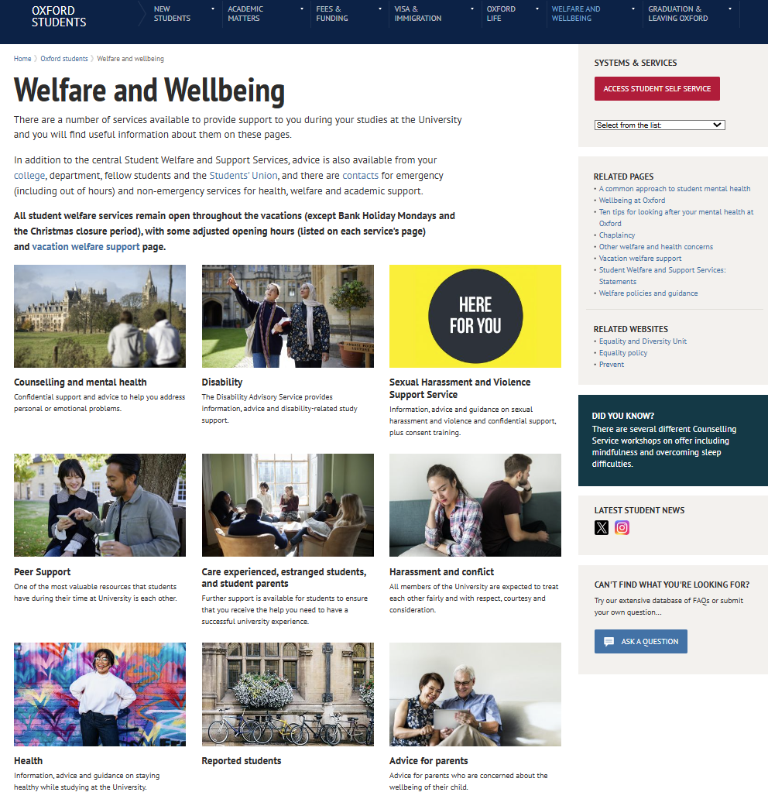
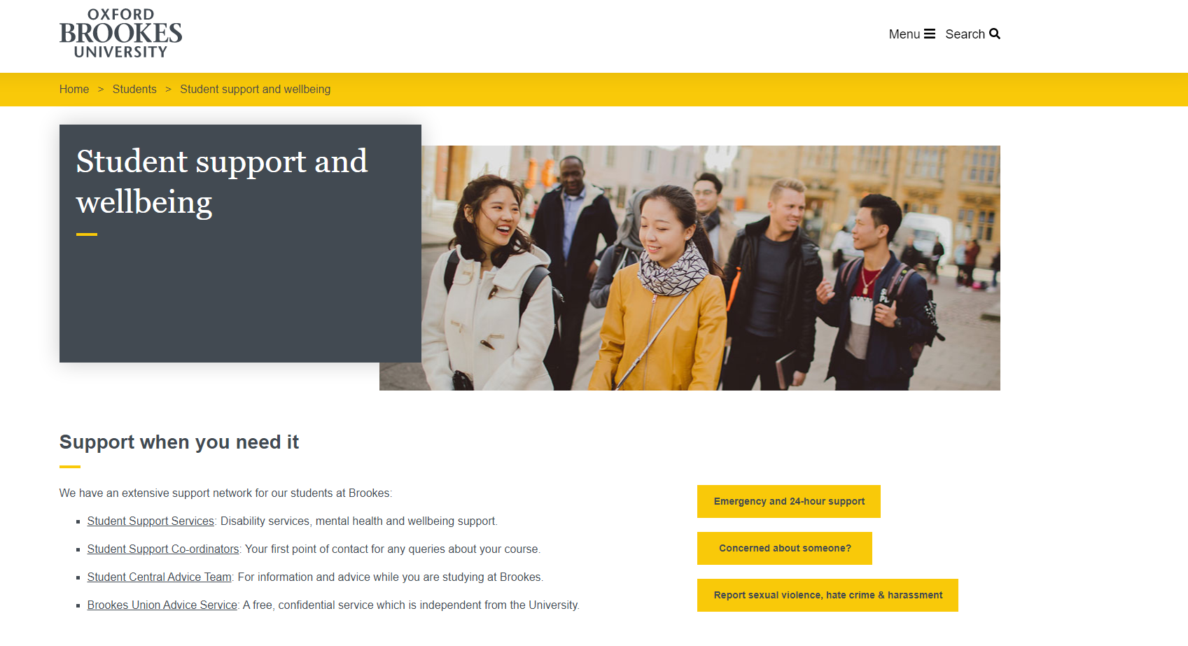
https://www.ox.ac.uk/students/welfare
https://www.brookes.ac.uk/students/support/

Slide 64
Student Welfare & Wellbeing
Student Welfare and Support Services
Departmental/institutional staff
  Tutor/Advisor
  Graduate studies office
  Disability advisor
  Harassment advisor
  Mental health first aiders
  Peer mentors
Colleges (e.g. Oxford)
Student Union
Helpline(s)
NHS

Slide 65
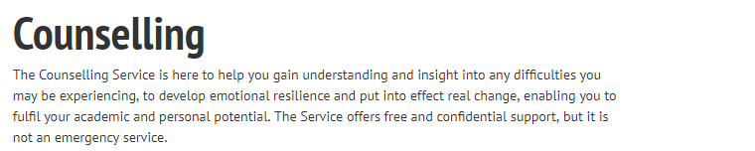

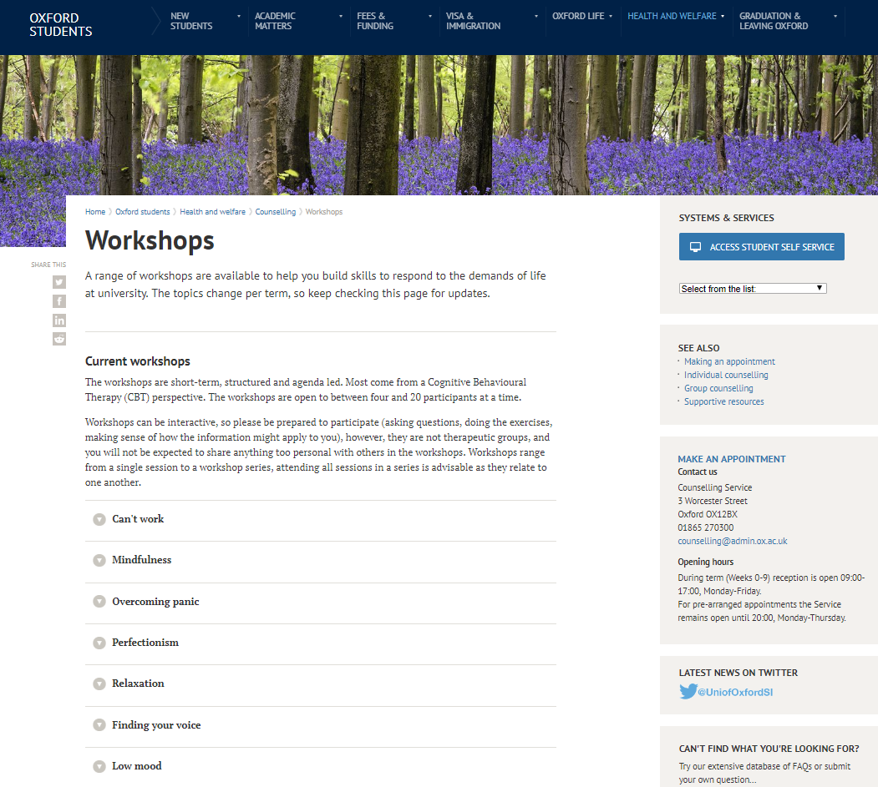
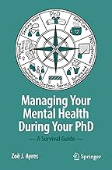
https://www.ox.ac.uk/students/welfare/counselling
https://www.brookes.ac.uk/students/wellbeing/counselling/

Slide 66
Disability, neurodivergence and health
Universities and research organisations aim to create inclusive, accessible environments
Where possible they will implement reasonable adjustments that will support you in your work and wellbeing
Neurodivergent students and students with disclosed disabilities have the opportunity to develop a student support plan with a disability advisor
Students are able to request adjustments during admissions processes and milestone assessments or examinations as needed
Students are encouraged to discuss adjustments with supervisors
It may be necessary to review adjustments as work progresses or circumstances change

Slide 67
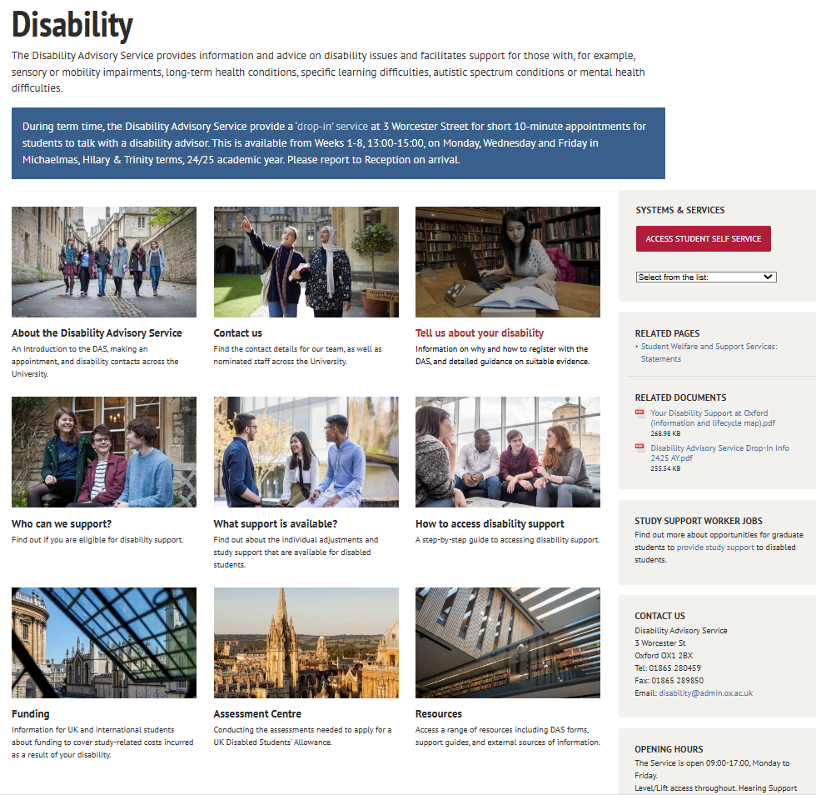

Slide 68
Disabled students allowance
Provided through your university or funder (e.g. UKRI)
A disability advisor will help identify any needs requiring additional support
Types of support available:
Equipment – hardware and software – including assistive technology and adapted furniture
Training in the use of specialist equipment or software
Insurance costs or warranties for specialist equipment or software
Non-medical assistance required to undertake postgraduate study – e.g. lip-speakers, note-takers, specific research assistance, environment-specific mobility trainers
Additional travel costs that arise as a direct result of a disability
Specific consumables – e.g. Braille paper
Costs may be incurred by the university before you start study and up until the viva and submission of the final thesis
Additional financial support may be available through organisations such as the Snowdon Trust

Slide 69
Medical leave and disability
Most courses will allow for a certain amount of planned or unplanned interruptions to full or part-time study due to sick leave
Some (but not all) funders provide paid sick leave for extended periods of illness
UKRI allows all students to take up to 28 weeks medical leave over a rolling 12 month period with the total amount of medical leave capped at 52 weeks for the studentship.
Students with long term health conditions or disabilities can apply to undertake their degree over a longer period of study by working part-time and through extensions to milestone assessments and the submission deadline
EHRC/UKRI - there is no need for a person to establish a medically diagnosed cause for their impairment. What it is important to consider is the effect of the impairment.

Slide 70
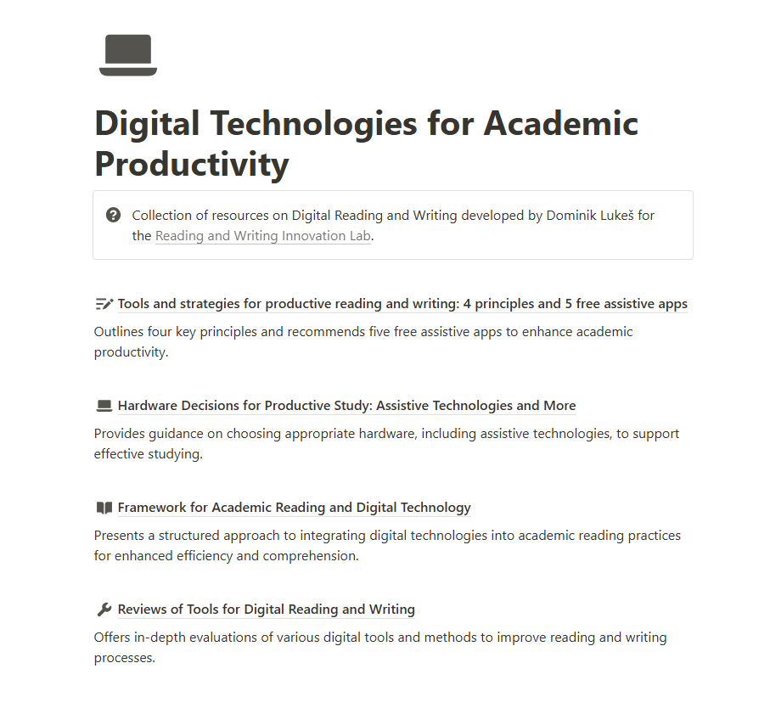
Digital technologies can enhance productivity for everyone…
https://academicproductivity.notion.site/

Slide 71
Setting SMART goals
S – Specific: I know what I want to accomplish, and why. I know how I will achieve this goal.
M – Measurable: I will know when a goal has been accomplished
A – Attainable: Knowledge, skills, abilities and resources (including your own time)
R – Realistic: Achievable by you while maintaining your wellbeing
T – Time-bound: Grounded within a specific timeframe

Slide 72
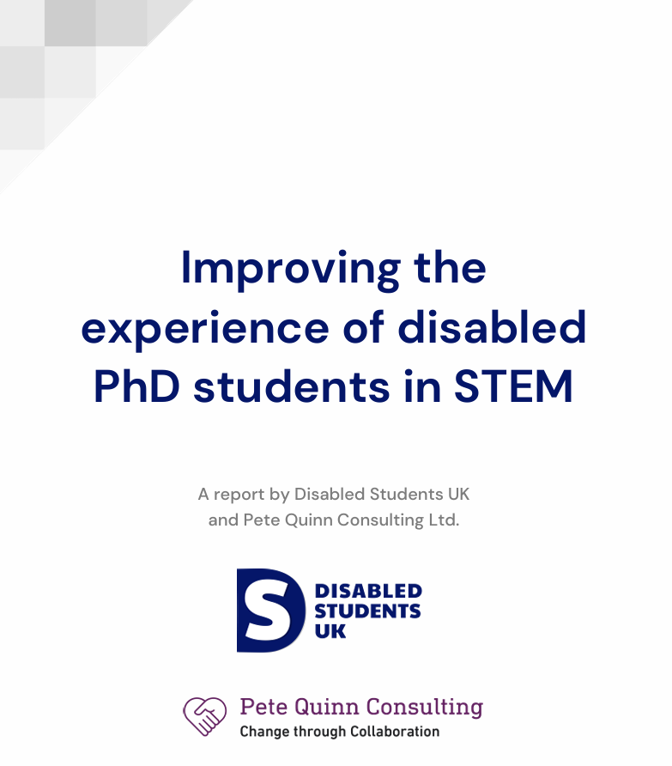
Finding a supportive supervisory team can make a difference
74% agreed that their
supervisors were flexible, accommodating, and valued their wellbeing (only 15% disagreed)
“My current supervisors are lovely, understanding and helpful. They help
me manage my time and my research, give me feedback that I can use,
help me break down tasks, make sure I don't break myself down while
working and support me in balancing my research with teaching opportunities.”

Slide 73
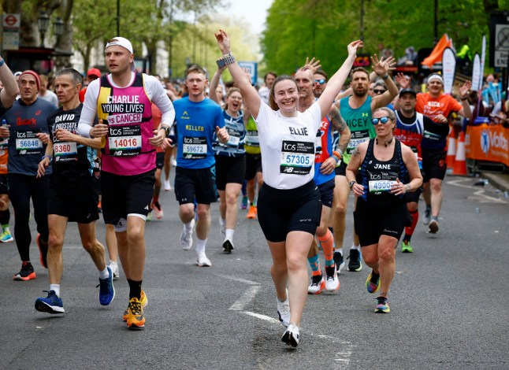

Slide 74


