Slide 1



Applying for postgraduate study
Gail PRESTON
co-director MPLS Doctoral Training Centre
OUImages/Ian Wallman
Notes:
Presentation will cover: Some basic information about the different types of courses, where to start when choosing a course, how to research and make your application, and information about fees and funding
Next slide

Slide 2

Figure out what excites you
Figure out what excites you
What are you good at? ...
What do you read about? ...
Team-based or individual? …
Computer, laboratory or field? …
What motivates you? ...
What are your values? …
What are your career goals? …
Ask questions, take notes ...
Be brave …
Experiment ...
Narrow things down ...
Notes:
Building on from sessions this morning

Slide 3

TIMELINE – 2027 entry
NOW:
Explore courses, supervisors and funding
Check the costs and funding options
Check the deadline
- new funded PhDs are advertised year round
2. Start the application
Check supporting documents required
Check application fee – and whether a fee waiver is available
Contact your referees
3. Submit by the deadline
Submit your application as early as possible
Keep in contact with your referees
4. After you apply
Shortlisting
Interviews
Offer decisions
Scholarship decisions (Jan-May)
Late applications for UK Masters programmes and some funded doctoral studentships – April-August
Notes:
We will look at some of these elements in more detail in today’s session

Slide 4
A PhD or a Masters degree?
A Masters degree is not usually required for sciences doctoral study in the UK
However, a Masters degree might be right for you if:
You want to study a subject more deeply than at undergraduate level, or to study topics not covered in your undergraduate courses
You want to gain or demonstrate additional knowledge, skills or research experience or gain experience of working in a new country/environment
You want to enter a career where a Masters degree is a valued or necessary qualification
Some universities offer dual Masters/PhD programmes – these typically involve assessed taught courses in the first 1-2 years and then an additional 2-3 or more years of research
Notes:
More info: https://www.ox.ac.uk/admissions/graduate/courses/choosing-a-course

Slide 5
Researching institutions, research groups
& programmes
Explore via:
Online resources
Recommendations – from academics/employers/students
Academic literature, conferences
Destination statistics
- What do postgraduates do?
Open days
FindAPhD.com
FindAMasters.com
jobs.ac.uk
Investigate:
Publications/Recommended reading
Encouragement to publish work and attend conferences
Finishing rates and times in that department/with that supervisor
Research group/department culture
Teaching/outreach/entrepreneurship opportunities
Networks and collaborations with other research groups
Is there a skills training component?
Interactions with industry/non-academic organisations
What is like to live there
Availability of language/other training
Funding

Slide 6
Routes to Doctoral Study
Supervisor selects students funding available
Supervisor/project-linked PhD
Supervisor nominates students to academic panel
competitive funding available
Supervisor selects or nominates students
unfunded offers
Academic panel selects students - admissions criteria and interview process
competitive funding available
- some programmes may also make unfunded offers
Doctoral programme
Landscape Award, Focal Award, DTP, CDT…

Slide 7
Finding a supervisor
Whether you need to secure a supervisor before applying varies by course and institution.
Search online for your area of research and look at potential supervisor profile pages on departmental websites
Confirm that their research is in your area of interest; consider reading their publications; look at their social media profiles
Email group leaders and potential supervisors to get more information and/or express interest (be concise and direct, attach your CV and your draft proposal if you have one)
Send a polite follow-up if needed; don’t contact more than one or two people at each institution at the same time; ask for further leads if appropriate
Read ‘How to find a research supervisor’
www.ox.ac.uk/admissions/graduate/application-guide/starting-your-application/research-project-and-supervisor
Notes:
More likely to be the case for PhD than for a Master’s
Identify any authors of research you might be interested in working with and check what universities they are working at
When applying for a PhD, you’ll need to make sure that there is appropriate supervision available for your work wherever you apply, though you don’t always need to secure a supervisor before your formal application. For Oxford, course pages will tell you if you need to contact a supervisor on the how to apply section.
Academic departments need to find appropriate supervision for you before considering an offer, even if you’re otherwise very qualified, so this is one of the most important factors in a competitive application.
Finding and usually contacting potential supervisors is important as staff in your research group or area will be asked whether they are happy to supervise you if you are accepted. However, you need to make a formal application and it is not enough to find a willing supervisor. Start early to make sure there is time to follow up with your full application.
Next slide

Slide 8
Applying for a DPhil/PhD with a specific supervisor: making contact
Read your potential supervisor’s publications and website
Contact your potential supervisor
    Contact is generally initiated via a polite, well-written e-mail.
    Always attach your CV and explain your interest in their research – be specific.
If there is a follow-up meeting
Be well-prepared to discuss their research and your interests – ask questions!
Interview “them”
Ask to speak with current or former students from their group
Discuss funding – if you already have ideas about how to fund your studies, and you are not applying for a funded position, mention this in your initial e-mail

Slide 9

Applying for a DPhil/PhD with a specific supervisor: making contact (what not to do)
Dear Prof. Preston,
I am a student at the University of Narnia. After glancing at your research summary I find you are interested in cerebellar diseases. I am working on <an unrelated topic>. I would like to continue to work on <unrelated topic> in your research group.
I am really interested to know if you would have any available PhD positions for September 2026. I have attached my CV for your consideration, but I also welcome any opportunity to discuss the possibilities with you by telephone or online in this regard.
Thank you in advance for your valuable time and consideration.
Kind regards,

Slide 10
Applying for a DPhil/PhD with a specific supervisor: making contact (what to do)
Dear Prof. Preston,
I am a student studying for an MSc in Frost Science at the University of Narnia. I have been following your work closely and I was particularly interested in your work on <specific research question/area> and intrigued by your observation that…. I am particularly interested in <areas of interest that align with the supervisor’s work>.
I am currently working on/have worked on xxxx. This has enabled me to develop skills in… My research experience includes…
I am keen to know if you have any PhD positions available for September 2026. I am particularly interested in <specific research questions/topic>, but I am also interested to know if there are other projects available. I have attached my CV for your consideration. I would welcome the opportunity to discuss any possible projects at your convenience.
Thank you in advance for your valuable time and consideration.
Kind regards,

Slide 11
Applying for a DPhil/PhD with a specific supervisor: making contact (what to do)
Dear Prof. Preston,
I am a research scientist working for <life science company>, who previously completed an MSc in Frost Science at the University of Narnia. I am writing to express my strong interest in applying for a PhD under your supervision. I have been following your work closely and I was particularly interested in your work on <specific research question/area> and intrigued by your observation that…. I am particularly interested in <areas of interest that align with the supervisor’s work>.
My research experience includes <previous work>. My current role has enabled me to develop skills in <relevant skills for doctoral study>. In the past year I have done <actions to prepare for doctoral study>. I am now committed to returning to doctoral study <reasons why you want to do a PhD>.
I am keen to know if you have any PhD positions available for September 2027. Although I am particularly interested in <specific research questions/topic>, I am also interested to know if there are other projects available. I have attached my CV for your consideration. I would welcome the opportunity to discuss any possible projects at your convenience.
Thank you in advance for your valuable time and consideration.
Kind regards,

Slide 12
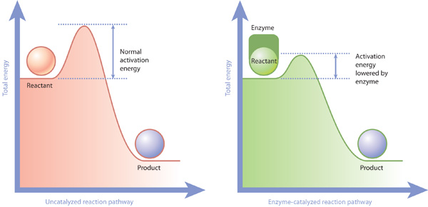
Most pre-application enquiries fail to overcome the “activation energy” needed to get a supervisor reply
No specific, well-informed interest in or knowledge of the supervisor’s work demonstrated in the initial letter
Inadequate written English in the letter or CV
No CV provided
Apparent poor fit between the candidate’s background and experience and the supervisor’s research interests
Notes:
The minimum energy needed for a chemical reaction to occur is called activation energy. This energy is the "hump" or barrier that reactants need to overcome to transform into products.

Slide 13
Additional supervisor concerns
I don’t know whether the applicant will have sufficient skills or background knowledge to work in my research area
  Include your skills in your CV - and where relevant - cover letter
  If you lack relevant skills or expertise don’t be deterred from applying - explain what skills you hope to develop in the future and how you plan to develop them, or how your existing skills and experience demonstrate your capacity to develop new skills.
  Develop and demonstrate your background knowledge in your enquiry letter, correspondence and meetings
A lot of our work is team-based, can the applicant work well in a team?
  Provide evidence of your team skills
I don’t have sufficient funding, supervision time, space or a suitable mentor in the laboratory to support them
  Request feedback on your application
  Ask for suggestions about other potential supervisors

Slide 14
Catalysts!
Mentoring
Research experience
Internships
Advocates
Networks
Awards/Prizes
Funding
Synergy
Supervisor experience
Diligence

Slide 15
Questions to ask supervisors
How many years does a PhD normally last under your supervision? (particularly for overseas groups – in the UK, it is usually 3 to 4 years)
What type of guidance will I receive at the beginning and throughout the project?
What is your approach to supervision?
How flexible is this project?
What funding is available? (Both for stipend/fees and research costs)
Will I be part of a year group or cohort for which specific support and training is provided?
What training in research skills is available?
Will I have the opportunity to teach, to undertake outreach, to develop entrepreneurial skills?
Will I have the opportunity to attend conferences?
Can I meet a member of your group?
Can I work remotely/part-time (if relevant to your personal circumstances)
Specific questions about the project to learn more and show you have thought and read about it

Slide 16

Personal statement
The ‘how to apply’ section on your course page will tell you whether you need a research proposal, personal statement, or both
It also contains course-specific guidance on things like length, structure and content
Your personal statement is your opportunity to tell your story to the academic department based on the facts in your transcript and other supporting documents
Think about the following questions:
What makes you stand out as an excellent candidate?
Why are you interested in your department/programme?
What do you hope to use your experience and qualifications for after you finish your course?
Notes:
Your course page will give specifics about what you need for that particular course, including whether you’ll need a personal statement, a research proposal or both, and how long that should be and what it should contain. It will also detail any written work required specifying the length. However, everyone will need things like a transcript and references.
Transcripts can also take a long time to come through from your institution so make sure you look into this at an early stage. If you have student self-service provided by your institution, for Oxford you can submit a screenshot or self-service grades as long as it has all your grade information, your name and your institution’s name clearly indicated.
Most courses will collect standard information that would usually be included in a CV via the application form. If your course needs a CV/resume, it will probably be quite short, just one or two pages, and should just focus on your academic and academic-related record.
We have a detailed Application Guide that covers requirements for each of these standard documents in detail, linked from every course page, so make sure you read that through before you start putting the application together.
For further advice and support on getting started, we have ‘how-to’ guides on our website about choosing references, and starting your research proposal or personal statement.
Next slide.

Slide 17
Research proposal
Your research proposal is your chance to show the department why your idea is important to your subject area
It aims to show your department why you are the best person to research your idea / topic
It should also generally include elements such as a research question, a brief literature review and the approaches you expect to use
Think about the following questions:
How does your proposed research build on existing research as well as your skills and expertise?
Is your project achievable in the time available for your course?
How do your department and proposed supervisor align with your research interests?
Notes:
Your course page will give specifics about what you need for that particular course, including whether you’ll need a personal statement, a research proposal or both, and how long that should be and what it should contain. It will also detail any written work required specifying the length. However, everyone will need things like a transcript and references.
Transcripts can also take a long time to come through from your institution so make sure you look into this at an early stage. If you have student self-service provided by your institution, for Oxford you can submit a screenshot or self-service grades as long as it has all your grade information, your name and your institution’s name clearly indicated.
Most courses will collect standard information that would usually be included in a CV via the application form. If your course needs a CV/resume, it will probably be quite short, just one or two pages, and should just focus on your academic and academic-related record.
We have a detailed Application Guide that covers requirements for each of these standard documents in detail, linked from every course page, so make sure you read that through before you start putting the application together.
For further advice and support on getting started, we have ‘how-to’ guides on our website about choosing references, and starting your research proposal or personal statement.
Next slide.

Slide 18
Applying to a Structured Doctoral Programme
Competitive entry
May admit students to undertake a specific project or students may be admitted to the programme with the opportunity to identify a research topic during the first year
Admissions decisions made by a panel of academics
Emphasis on selection criteria, fit to remit and research potential
Need to provide a well-researched statement of research interests that shows an understanding of the remit of the programme, training provided by the programme and the expertise and interests of potential supervisors in the institution(s) involved
Some funding may be available for overseas students – check before applying
Notes:
Handover to Kate

Slide 19
Applying for graduate study – the process
OUImages/Ian Wallman
Notes:
Presentation will cover: Some basic information about the different types of courses, where to start when choosing a course, how to research and make your application, and information about fees and funding
Next slide

Slide 20
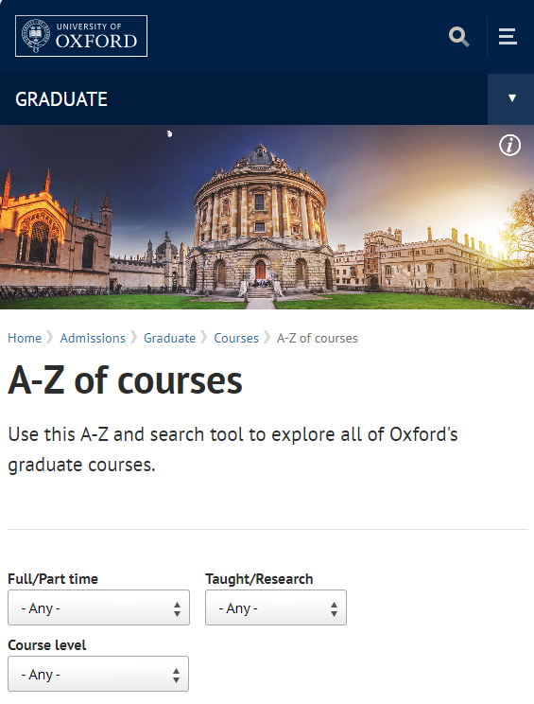
Our website
www.graduate.ox.ac.uk has information on:
  Courses, including entry requirements
  Fees and funding
  Colleges
  How to apply
You can filter Oxford’s full course list by length, master’s/research and academic department:
  https://www.ox.ac.uk/admissions/graduate/courses/find-your-course
Notes:
Oxford University graduate webpages are the main source of information when you are choosing and applying for a course. They include information on courses, funding, colleges and how to apply. Take time to research your options looking at both the University webpages and department webpages.
Our courses A to Z has a full list of over 330 graduate courses with options to search and filter by length, level of the course, whether it’s taught or research-based, and the academic department. We also have a course list organised by department if you know exactly which academic department you’re interested in.
Information is currently available for 2025-26 entry and things may change for future years, but you can use it as a general guide to what things may be like if you wish to apply for graduate study in future years. For other universities this will also be your starting point and their websites will contain similar information. You may also want to consider external websites, eg FindAPhD if you want to compare programmes.
Next slide.

Slide 21

Entry requirements
A strong upper second class (2:1) or first class (1st) undergraduate degree with honours, depending on course
For international qualifications, see www.graduate.ox.ac.uk/iq
Your undergraduate degree may need to be in a relevant discipline or have included specific skills (e.g. quantitative preparation for Economics)
Proof of English language proficiency in one of IELTS, TOEFL, Cambridge English or Oxford Test of English Advanced (not needed at point of application) at ‘Standard’ or ‘Higher’ levels of minimum scores
OUImages/Ian Wallman
Phil Brooks
Notes:
Entry Requirements
Check ‘entry requirement’ section of the course page to see if it’s strong 2:1 or first.
You may need a very closely related course or there may be a range of subjects that are a suitable background, depending on the course
If you are unsure if you meet a course’s entry requirements, contact the academic department (details are on the right hand side of the course page)
There are some situations in which you can request an English language test waiver

Slide 22

Application deadlines
At Oxford almost all courses have a deadline in early December, early January or late January – but only one of these deadlines
Other universities may use fixed or rolling deadlines
Check the deadline for your course as early as possible – different courses use different deadline dates
At Oxford, deadline dates for 2026-27 entry are confirmed in September
To be considered for Oxford scholarships, you’ll need to apply by the December or January deadline.
Programme/project-specific studentships may be available later in the admissions cycle
Phil Brooks
Notes:
You will usually need to apply by the December or January deadline for your course.
There are a number of December and January deadlines so please check yours as soon as possible. Be aware that two courses in the same subject area may use different deadlines.
To be considered for Oxford scholarships, you would usually need to apply by the December or January deadline, though there may be departmental studentships and other funding sources with different deadlines. Any given programme generally uses EITHER the December deadline OR one of the January deadlines.
Many courses close after the December / January deadline.
Next slide.

Slide 23
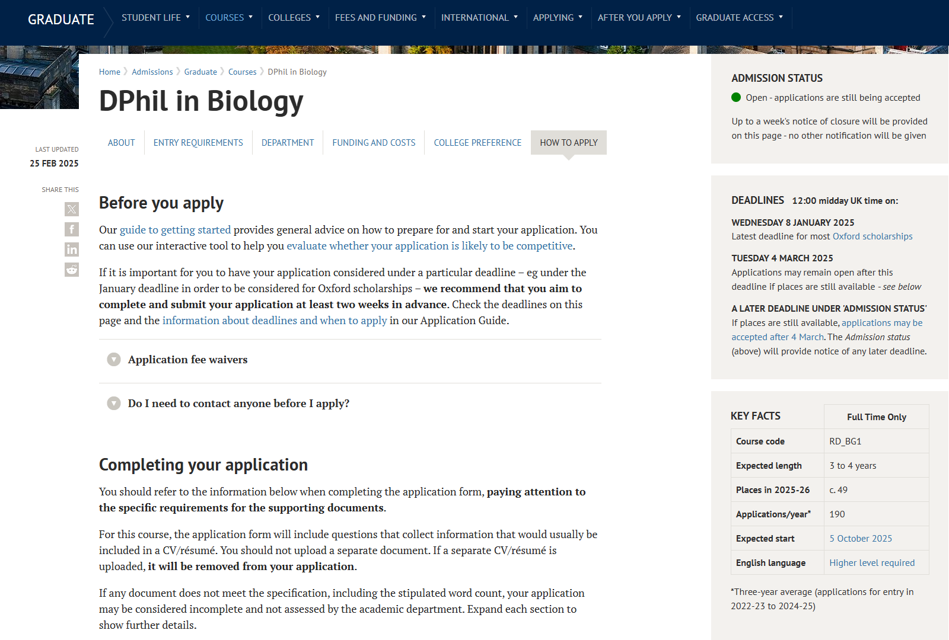
How to apply
Review the chosen course information page carefully
Look at the ‘How to apply’ section for what you need to do and for the link to the application form
Check what documents you need
Check if you need to contact a supervisor before applying
Notes:
The course information page provides information about the course, entry requirements, information about funding and costs and the deadlines
In particular, the ‘how to apply’ section of the page shows you all the documents you need to apply for a given course.
Each course page is unique to that course, so make sure you know what documents you need to supply.
Next slide

Slide 24
Supporting documents
Supporting documents at Oxford include:
  Personal statement and/or research proposal (depending on the course)
  Official transcript(s)
  Three references, submitted directly by referees
Some courses require written work, an admissions exercise or other documents
Standardised CV for most courses
→ Our detailed Application Guide covers requirements for each of these standard documents: www.graduate.ox.ac.uk/applicationguide
Notes:
Do include your employment history in your CV.
Your course page will give specifics about what you need for that particular course, including whether you’ll need a personal statement, a research proposal or both, and how long that should be and what it should contain. It will also detail any written work required specifying the length. However, everyone will need things like a transcript and references.
Transcripts can also take a long time to come through from your institution so make sure you look into this at an early stage. If you have student self-service provided by your institution, for Oxford you can submit a screenshot or self-service grades as long as it has all your grade information, your name and your institution’s name clearly indicated.
Most courses will collect standard information that would usually be included in a CV via the application form. If your course needs a CV/resume, it will probably be quite short, just one or two pages, and should just focus on your academic and academic-related record.
We have a detailed Application Guide that covers requirements for each of these standard documents in detail, linked from every course page, so make sure you read that through before you start putting the application together.
For further advice and support on getting started, we have ‘how-to’ guides on our website about choosing references, and starting your research proposal or personal statement.
Next slide.

Slide 25

Contextual information
All institutions collect diversity data as part of monitoring and reporting processes – this is not normally available to assessors
Some institutions and programmes, including Oxford, collect additional contextual data to inform decision processes
Some institutions, including Oxford, also allow students to provide a contextual statement and/or statement of extenuating or special circumstances that may inform decision processes. Sensitive information will not normally be shared with assessors.
Phil Brooks
Notes:
Think early about who your references will be - usually your references should be academic staff familiar with your work, including your current supervisor if you’ve been doing research. For some courses, a professional reference may be acceptable.
As soon as you start your application, ask your referees directly if they’re happy to submit a reference for you by the deadline date, then once you’ve got the go-ahead, register your referees in your application form. Adding them to the form will generate a reference request that includes the title of the course you’re applying to and the deadline you’ve specified for your references in your form. We’d recommend you do this as early as possible so that they have as much notice as you can give them.
Make sure that you give a date no later than the application deadline - we pre-populate the deadline dates in the form for you. Double-check with your referee that they’ve got this email and keep in touch until they’ve submitted. The form will send you an email every time a reference is submitted and Referees will receive a confirmation email when they submit a reference. If your referee doesn’t get their request email, ask them to check their junk or spam filters.
It’s especially important to keep on top of things with your references as your application might not be considered if we don’t receive them on time.

Slide 26
Contextual or extenuating?
Contextual – general background information e.g.
are in the first generation of your family to go to university;
have been in care for at least three months;
have been or currently are a carer;
are from a low-income background;
are a refugee;
are neurodivergent;
have or have had one or more disabilities or chronic illnesses that have affected you in education or at work
Extenuating – specific factors that have affected the strength of your application for which no mitigation was available e.g.
bereavement or medical issues during degree study and examinations
Phil Brooks
Notes:
Career gaps. Think early about who your references will be - usually your references should be academic staff familiar with your work, including your current supervisor if you’ve been doing research. For some courses, a professional reference may be acceptable.
As soon as you start your application, ask your referees directly if they’re happy to submit a reference for you by the deadline date, then once you’ve got the go-ahead, register your referees in your application form. Adding them to the form will generate a reference request that includes the title of the course you’re applying to and the deadline you’ve specified for your references in your form. We’d recommend you do this as early as possible so that they have as much notice as you can give them.
Make sure that you give a date no later than the application deadline - we pre-populate the deadline dates in the form for you. Double-check with your referee that they’ve got this email and keep in touch until they’ve submitted. The form will send you an email every time a reference is submitted and Referees will receive a confirmation email when they submit a reference. If your referee doesn’t get their request email, ask them to check their junk or spam filters.
It’s especially important to keep on top of things with your references as your application might not be considered if we don’t receive them on time.

Slide 27
References
Think early about who your referees will be – usually academic staff or professional colleagues who are familiar with your work
Approach referees in good time to check that they can provide a reference – and what type of reference they can provide
Register referees in the application form as early as possible
References must be received by the course deadline - if references are late, applications might not be assessed.
Phil Brooks
Find more tips for references on our website
https://www.ox.ac.uk/admissions/graduate/application-guide/references
Notes:
Think early about who your references will be - usually your references should be academic staff familiar with your work, including your current supervisor if you’ve been doing research. For some courses, a professional reference may be acceptable.
As soon as you start your application, ask your referees directly if they’re happy to submit a reference for you by the deadline date, then once you’ve got the go-ahead, register your referees in your application form. Adding them to the form will generate a reference request that includes the title of the course you’re applying to and the deadline you’ve specified for your references in your form. We’d recommend you do this as early as possible so that they have as much notice as you can give them.
Make sure that you give a date no later than the application deadline - we pre-populate the deadline dates in the form for you. Double-check with your referee that they’ve got this email and keep in touch until they’ve submitted. The form will send you an email every time a reference is submitted and Referees will receive a confirmation email when they submit a reference. If your referee doesn’t get their request email, ask them to check their junk or spam filters.
It’s especially important to keep on top of things with your references as your application might not be considered if we don’t receive them on time.

Slide 28

Decision timeline
After the deadline, applications are checked and passed to the department for review.
Depending on the course, you may be interviewed (usually online).
You will usually find out by email whether your application is successful 8 to 10 weeks after the application deadline.
→ Explore the decision timeline on our website: www.graduate.ox.ac.uk/afteryouapply
Phil Brooks

Slide 29
The interview process
Assessors are generally looking for:
  Evidence of academic and research ability
  Motivation and enthusiasm
  Understanding of the aims, objectives and remit of the programme/project you are applying for
  Suitability of the programme/project to meet your aims
  Ability to work in a team environment
  Communication skills
  Core competencies (e.g. problem-solving, quantitative skills)
Phil Brooks

Slide 30
The interview process
  May begin with a formal or informal interview with a supervisor prior to or after applying
  There may be one or more formal interviews (online or in person)
  Typically 30 minutes
  Prospective supervisors may or may not be present for the formal interview
  Doctoral interviews frequently include a short presentation or questions on previous research
  There may be a pre-interview test (depends on programme and subject area)
  Some interviews may include skills-based questions – e.g. maths or coding
  It is possible to request reasonable adjustments

Slide 31
Set yourself up for success - Part 1
Ensure you are well aware of the background literature and context for your previous project(s)
Keep a broad interest in the field and other research
Be able to explain what you have done and directions for future work
What challenges have you had to overcome? How did you approach them? (What does your answer say about you – resilience, commitment, creativity, willingness to seek assistance… )
Be able to explain and justify your ideas for future work
If asked to give a presentation – practice it, make sure you can stay within the time allowed, get feedback

Slide 32
Set yourself up for success - Part 2
Ensure you are well aware of the potential project(s)/areas you are interested in
What are the hypotheses/questions?
What methods are involved?
What challenges might you face?
What excites you about it?
What do you have questions about?
Phil Brooks

Slide 33
Set yourself up for success - Part 3
Check whether the invitation to interview states which questions or topics will be discussed/addressed
Prepare to address those questions/topics – think about a range of examples
If you present your previous work, make sure you provide contextual information and state your aims/hypotheses clearly – remember that your interviewers will not be experts on your research topic
The last question of the interview is likely to be “Do you have any questions?”

Slide 34
Interviewing as a returning student
If asked to present on previous research/work:
  Think carefully about what to present and if needed refresh your knowledge
  If relevant – consider how to present professional work in a way that demonstrates your potential as a doctoral student while retaining any essential confidentiality
  If necessary it may be possible to request an alternative – e.g. to give a presentation on a scientific paper of personal interest or set by the programme
Reflect on your strengths and how to demonstrate them
  Breadth of experience and professional skills
  Evidence of resilience, commitment and motivation
  Evidence of problem-solving and team skills
  Communication skills
Phil Brooks

Slide 35
Accessing Information

Slide 36

How to apply
Apply and send all documents online and by the deadline
Most deadlines are 12 midday UK time on the deadline date
Apply early– try to submit two weeks before your chosen deadline
Application cap of 2 applications (3 if at least one is research) per cycle – but strongly recommended to focus on one application
Phil Brooks
Notes:
The whole application form and process is fully online – don’t leave it to the last minute to submit. You’d be surprised how many people find their wifi cuts out on deadline day. We strongly recommend that you submit your application form and all of your supporting documents at least two weeks before your chosen deadline. It’s so much easier for us to help you solve any last-minute issues even a week or two before the deadline than it is on the deadline date.
At Oxford there is usually an application fee but we have waivers for some situations, including waiver schemes aimed at improving postgraduate access.
Next slide

Slide 37

Oxford scholarships
Each year new Oxford postgraduates benefit from over 1,000 full or partial scholarships offered by the University, its academic departments/units, colleges and others
About 50% of postgraduate students are fully funded, either by Oxford or external funders, but disciplines have different levels of funding.
Phil Brooks
Notes:
You should consider how you will fund your graduate course as early as possible – as soon as you start researching your options.
Good news – we have generous scholarship funding here at Oxford
Over 1000 scholarships are expected to be available for entry in 2025-26, both full and partial scholarships
By full scholarships we mean that they cover course fees and a grant for living expenses (currently over £19k per year).
Scholarships may be funded by the university, departments and colleges as well as external sources.
Usually scholarships are awarded on the basis of academic merit and potential.
We have some scholarships for groups underrepresented in graduate study at Oxford, for example, the Academic Futures scholarships

Slide 38

Applying for Oxford scholarships
Make sure you apply by the December/January deadline for your course.
A standard course application is required for the majority of our scholarships – you will be automatically considered if you meet eligibility criteria.
Some schemes require additional material, e.g .supporting statements
→ Use our Fees, Funding & Scholarship Search tool to explore scholarships with additional requirements | www.graduate.ox.ac.uk/fundingsearch
Phil Brooks
Notes:
We try to make it as easy as possible so for over two thirds of our scholarships all you need to do to be considered is submit your course application for graduate study by the December or January deadline and, if you fulfil the eligibility criteria for the scholarship, you will be automatically considered.
The remaining scholarships will require additional materials, for example, a supporting statement or you may just need to tick a box on the graduate application form to apply.
You can use the Fees Funding and Scholarships Search tool to find awards you are eligible for which require a proactive application. Please note that this tool is a general sign posting tool; you need to follow the link it provides and read the full details of each award to determine whether you are eligible for it or not.
That is all from me. It has been a pleasure to be here with you this afternoon. I wish you all good luck with your applications for graduate study at Oxford and with securing funding!
Next slide

Slide 39

Top tips for funding
Make sure you’re clear about likely costs (fees and living expenses) – remember that the offer of a place doesn’t guarantee funding
Check deadlines and what, if any, supplementary materials are needed for particular scholarships
Don’t wait until you have an offer or start your course to sort out funding for future years
Work opportunities may be limited so it is unlikely that you will have time to earn enough to fully support full-time study
Phil Brooks
→ Review our guidance and resources on finding funding for your course | www.graduate.ox.ac.uk/funding
Notes:
Hand over to SFF
Be practical about funding and start looking as early as you can – don’t wait until you apply.
Make sure you’re clear about likely costs (fees and living expenses) and aware that the offer of a place does not guarantee funding.
Check deadlines and what, if any, supplementary materials are needed for particular scholarships – start as early as possible on your research.
Understand external scholarships and other potential sources of funding, e.g. websites such as www.postgraduate-funding.com
Do note, there won’t be time to earn enough through paid work to fully support yourself while you are studying a full-time course. Don’t try to do that – it most likely will lead to stress and financial hardship.
Next slide

Slide 40
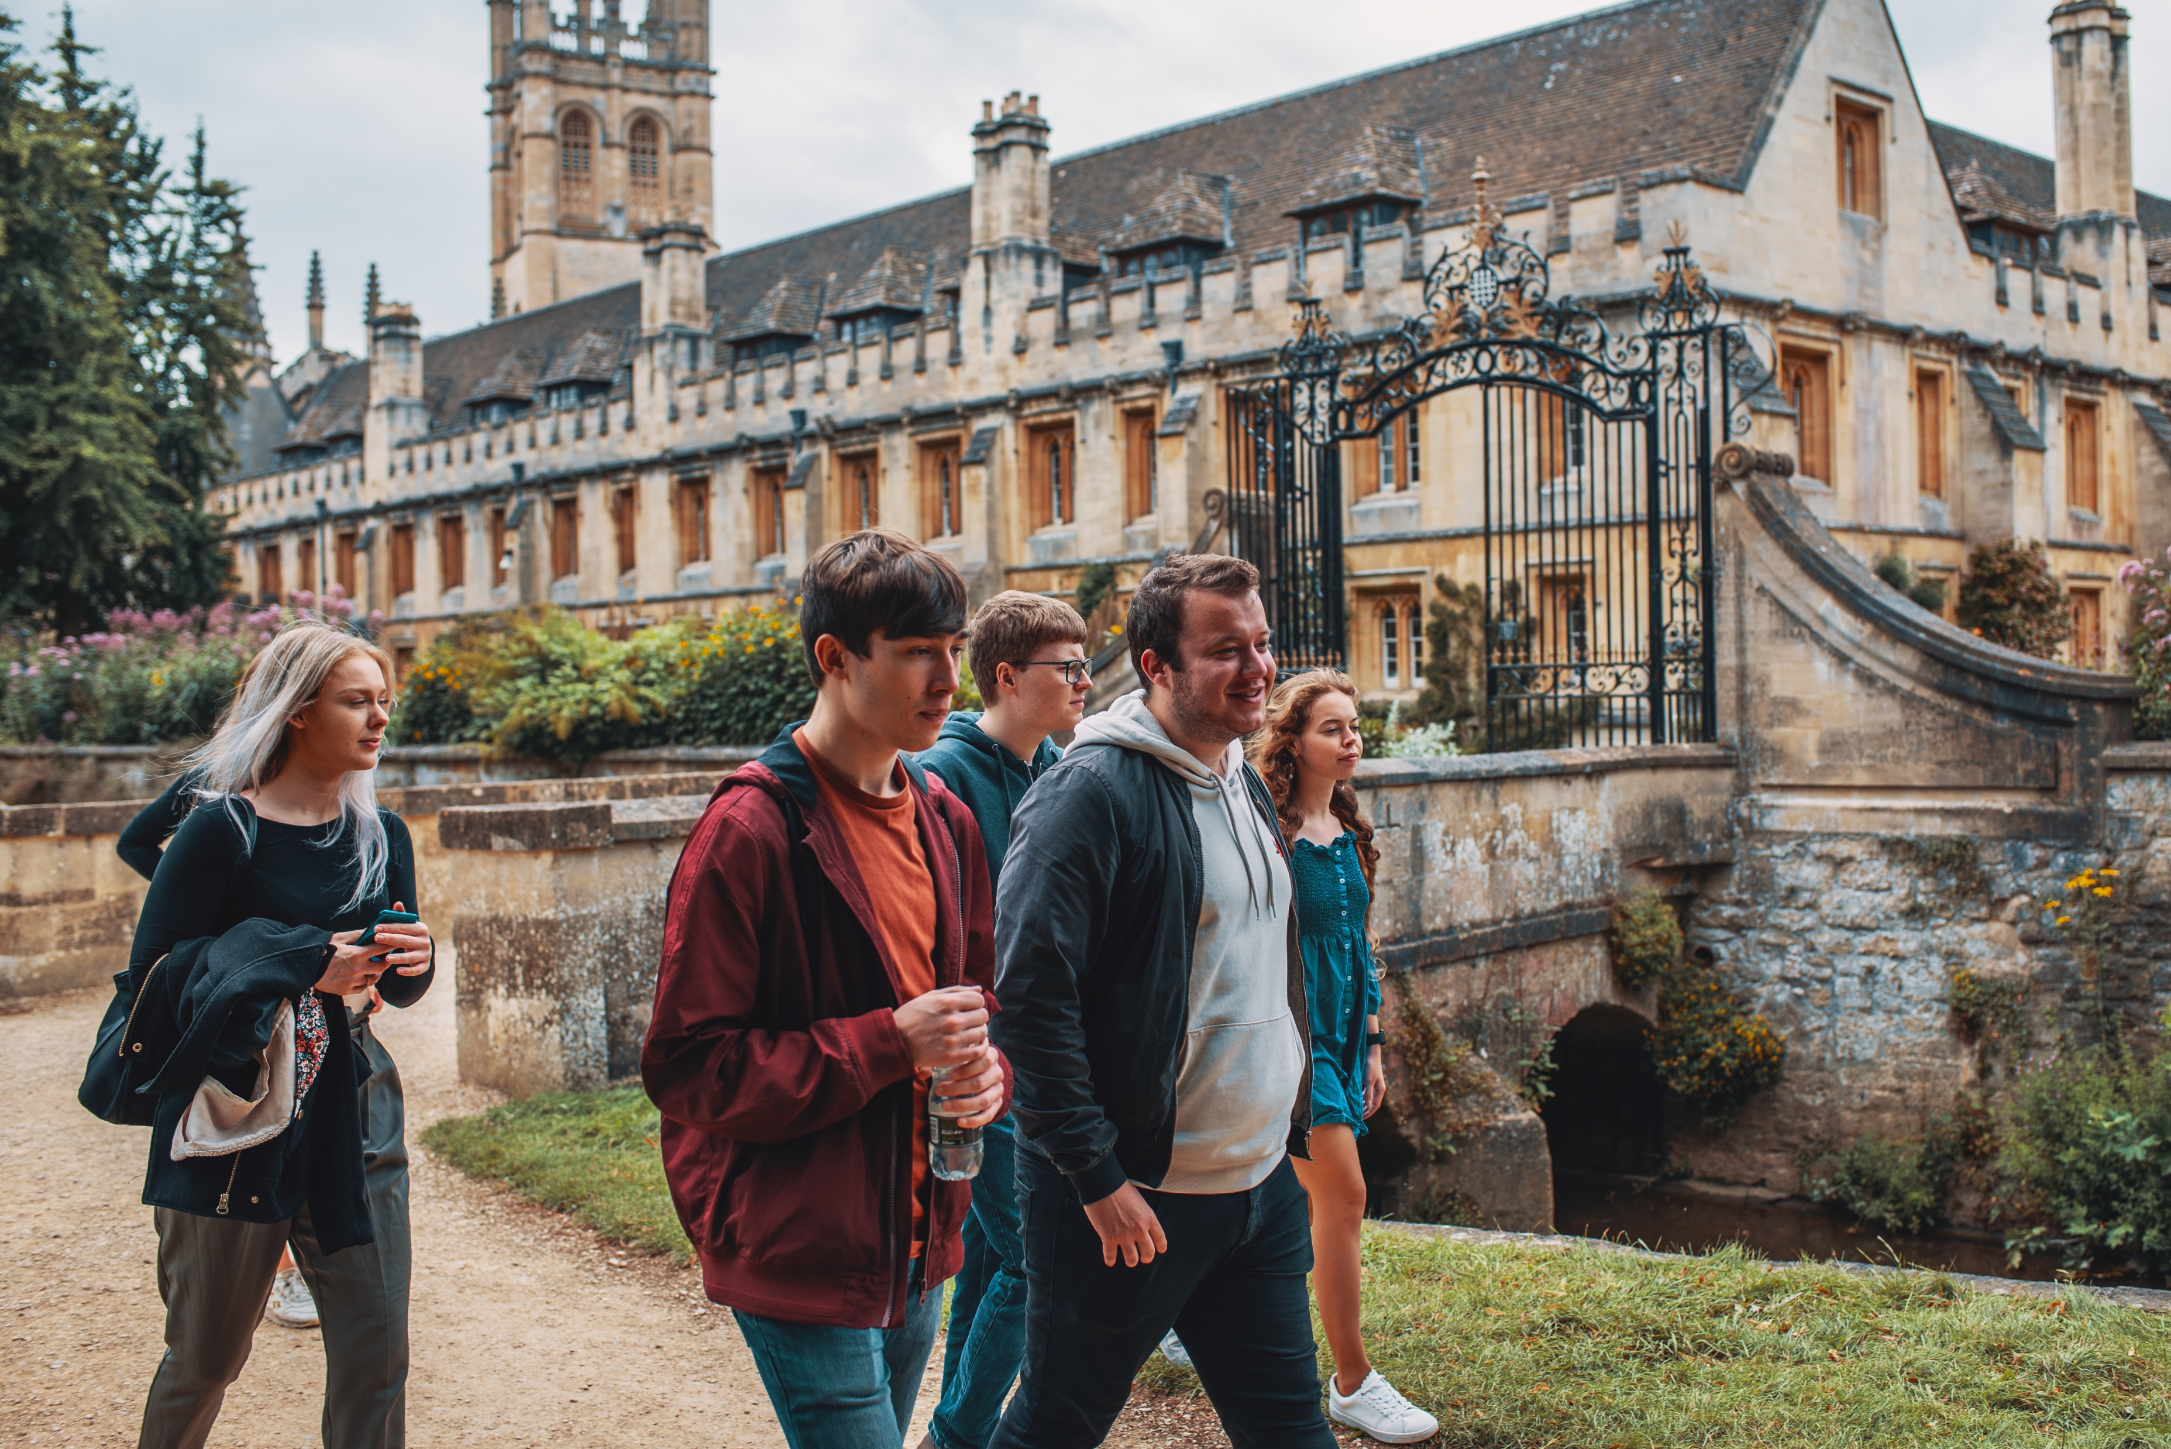
Oxford’s colleges
All students are members of a department and one of 43 unique colleges
Colleges are small, multidisciplinary communities with students and staff from different backgrounds and subjects
Most colleges accept graduates and undergraduates, but some only accept graduates
There is no separate application for colleges. All DPhil and masters’ students have a guaranteed college place
You don’t have to give a college preference when applying
Phil Brooks
Notes:
All colleges have their own unique character, not just in their buildings but in their community of staff and students, who come from different backgrounds and subjects.
We believe that this diversity can add depth to your academic experience, and provide opportunities for powerful interdisciplinary collaborations and exploring avenues for your research you might not otherwise have considered.
Colleges are also a home away from home – they will usually offer pastoral support and facilities like catering and accommodation, as well as sports teams and student groups.

