Slide 1


The Application process

Slide 2
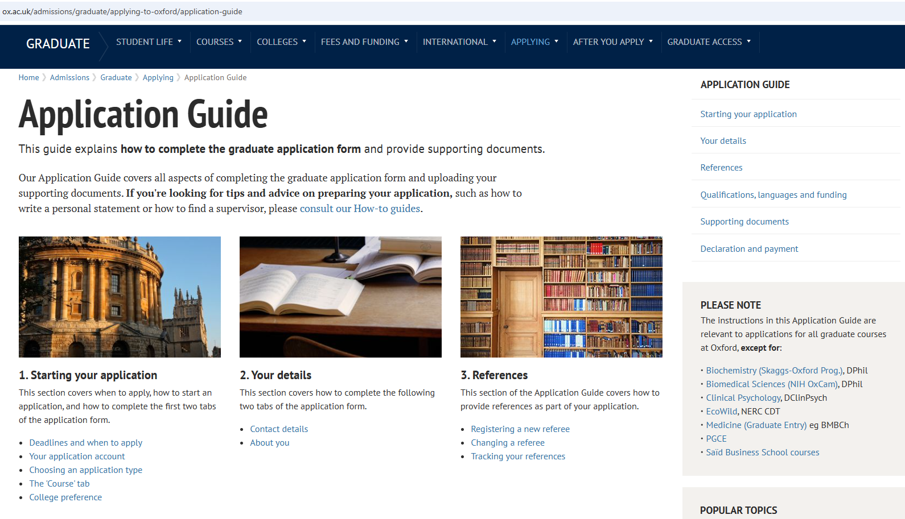
where to apply
All ILESLA applications regardless of the university you wish to apply to, are made through the Oxford application portal
Notes:
There are a number of reasons why we are now doing this but the most important is to ensure absolute fairness and consistency of approach to applicants.
Also to avoid multiple interviews taking place for candidates applying to more than one of the institutions.

Slide 3
questions to ask yourself
Where are you going to carry out your project?
Do you have a supervisor in mind already?
Are there several people you might want to work with in different places?
Would you be interested in an Industrial collaboration?
Notes:
You can carry out a project physically based at any of the six main hosting partners. You cannot apply to Pirbright, Diamond or ISIS for entry however, you must be admitted to one of the three universities.
There is always confusion over whether a supervisor has to be named on the application. It is not required that you name a supervisor, but many people do already have an idea who they might like to work with and this is helpful for us to know during the assessment process as it is a strong indicator of your interests. It’s also very common for candidates to contact potential supervisors to discuss research topics.
If you do have several supervisors in mind, at different places, we need this to be clear on the application. We won’t know all the names of the supervisors at the six hosting partners. There are over 700 registered supervisors and the number is rising.
If you are interested in working with an Open-IIC partner, you need to make this clear on the application, I’ll explain how to do that further down.

Slide 4
follow the guidance
Links to the relevant application pages are on the ILESLA website “how to apply” page https://iles.web.ox.ac.uk/how-apply
There is also a course page on the main Oxford website which has detailed guidance on completing the application form. https://www.ox.ac.uk/admissions/graduate/courses/dphil-interdisciplinary-life-environmental-science
Notes:
Although Open and Brookes have their own admissions web pages, and ILESLA pages, these will re-direct you through to the Oxford course pages so these should be your primary source of information and support.
ILESLA website how to apply section which includes a bit more information about how the finances work, how supervision will work and a searchable list of eligible supervisors you can look through to identify individuals in all the hosting partners whose interests might align with your own. It explains a bit more about the entry route into the programme, some of our close partner colleges (a shorter list than on the main admissions course page) and some specific instructions on completing the form.
it also points through to the main Oxford course page.

Slide 5
key examples
In particular:
Proposed Thesis Topic -Do not enter your proposed PhD project in this field.
Instead, we need the main ILESLA research themes separated by a comma and indicate if you are interested in an Open-IIC collaboration, as follows:
Biodiversity and Sustainability, 2. Rules of Life, Open-IIC
Proposed Supervisor
If naming supervisors, you must put their organisation in brackets after their name so we know where you are applying.
Name Surname (Open), Name2 Surname (Oxford Brookes), Name3 Surname (Pirbright)
Notes:
There is only one application form, we are not able to have our own form, there are very few fields where information specific to our programme can be entered, therefore we have to re-purpose some of the fields to obtain it.
The instructions are there to assist quick and accurate assessment of your application. It may disadvantage your application if you ignore these instructions. Admin staff need to extract this information into spreadsheets and split it into columns which is why we request it in this format, it creates a lot of work if we have to go through manually.

Slide 6
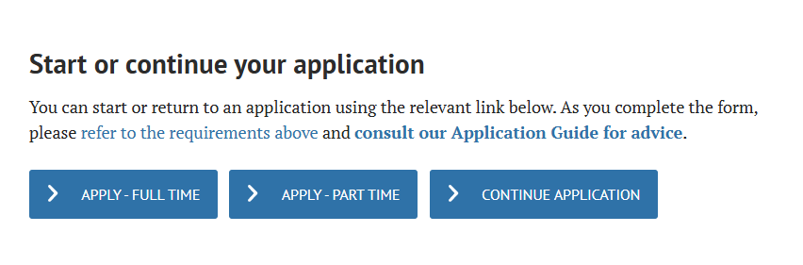
Steps of an application
You need to create an account. To do this:
Go to course page https://www.ox.ac.uk/admissions/graduate/courses/dphil-interdisciplinary-life-environmental-science
How to apply tab
Hit the relevant button

Slide 7
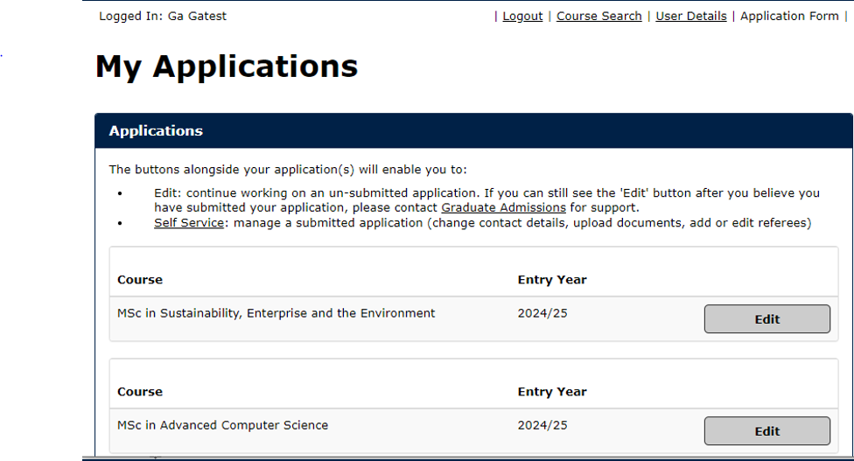
create an account
Remember which email address you used to create the account

Slide 8
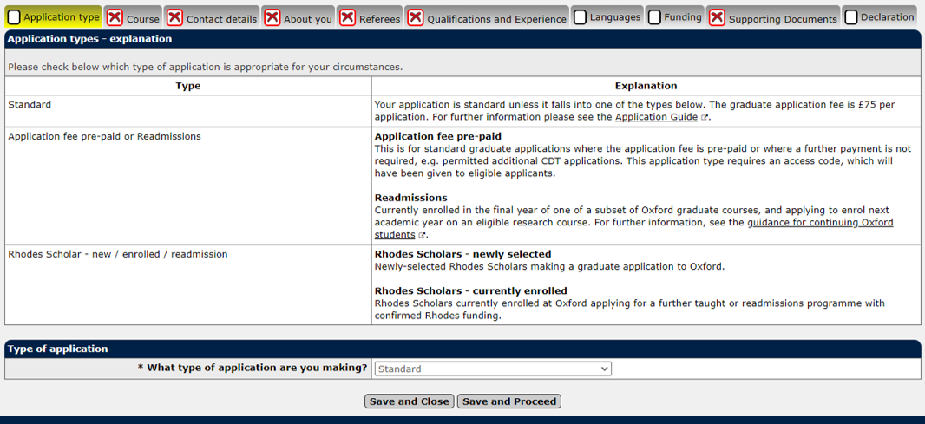
the form
Notes:
The form has a number of tabs for different types of information. You need to complete all of the information requested in order to get a green tick in the tab box.

Slide 9
extenuating circumstances
Must be something not addressed by previous institution
Focus on impact of circumstances rather than describing what happened
Write a contextual statement and submit alongside your application form if you do want to give more detail.
Notes:
If you feel that your academic record does not reflect your true potential because of various difficulties you have faced during your life or career so far, there are two places you can tell us about this. There is an extenuating circumstances field on the application form itself where you can make this clear, with a couple of provisos:
If you already had support from your previous institution to mitigate that event it’s not appropriate to include it on the form.
Don’t go into too much detail on the event, often this will be personal information. It’s the impact that is the important information.
Separate from the application form, you can submit a contextual statement to give more detail. There is a link to this form on the main course page.

Slide 10
supporting documents
CV – template is provided, do not upload an alternative CV
3 referees
Statement of Purpose – 1000 words
Socio-Economic Data questionnaire – (used to apply banding and monitor equity)
Official Transcripts
Language qualifications –TOEFL/IOELTS (if available) NB avoid booking TOEFL tests after 21st Jan
Contextual Statement –information on your socio-economic background or personal circumstances in support of your application.
Notes:
TOEFL has recently announced changes to its iBT English test, which are scheduled to be implemented on 21 Jan 2026. These include shortening the test, incorporating non-academic elements and (we understand) introducing AI marking. It has, therefore, been decided that a detailed review should take place to establish whether the University should continue to accept it as a valid test to meet our English proficiency requirement.
They do not need to meet the English requirement at the time of applying and any scores will not affect the academic assessment of their application. If they are offered a place on a graduate course and are required to demonstrate English proficiency, they will be given time to meet the English language condition.
TOEFL iBT tests taken before 21 January 2026 will be accepted as normal
Those needing to take a remote test because they can’t access an in-person test centre (so can’t choose IELTS), can instead take the Oxford Test of English Advanced
Information on the tests we accept and the required scores is available on the graduate admissions website
Referees should be academic. If you are a returning student then professional references can be accepted but at least one should be academic in this case.
Transcripts if available

Slide 11
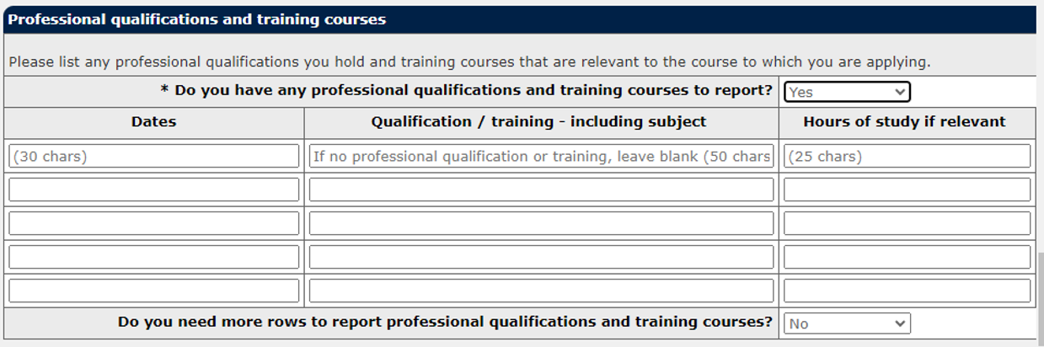
CV template
We use a CV template with specific questions on it, do not upload your own CV.

Slide 12
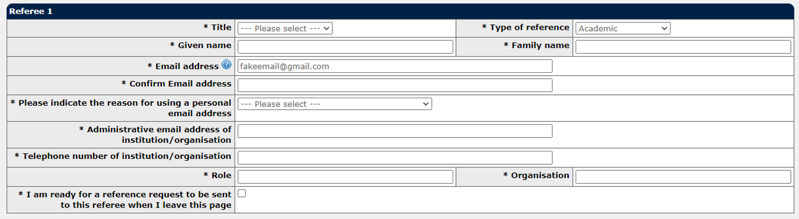
registering referees
3 references, regardless of which institution you apply to
Register them as soon as you can
Do not get the references and attach them to your application – the system will contact the referees directly.

Slide 13
application fee waivers
Applying only to Open and/or Oxford Brookes
Applying from a low income country
UK applicants from low income backgrounds
Refugees and displaced persons
Receiving benefits
Graduate Access programme applicants (UNIQ+)
Applying for re-admission (current Oxford PGTstudents)
Applying to related research courses (e.g. DeptD.Phil)
Applying only to Open and/or Oxford Brookes
https://www.ox.ac.uk/admissions/graduate/application-guide/declaration-and-payment/application-fee-waivers
Notes:
Oxford charges a £20 application fee for PhD applicants. However some people are eligible for a fee waiver.
Those applying only to Open/Oxford Brookes can get a fee waiver code from the Open/Brookes graduate administrators that they can use at the point of payment.
Others in the eligible list can apply direct to Graduate Admissions and funding via the main course page. To check eligibility and apply visit this link

Slide 14
interviews
All interviews will be held remotely
30 minutes long
5 minute presentation
All interviews held to the same strict format and questions
Invitations go out at least 7 days before
Please confirm attendance as soon as possible
Guidance on questions will be available in advance, an interview briefing will also be offered.
All applicants will receive an outcome via the application portal. Please be patient and don’t email administrators who will be following a strict order of contact.

Slide 15
offers
You will be normally be notified of an offer within 7 days of the decisions meeting.
Initial offer email
Offer certificate
Waiting list is run
Further offers go out to those on the waiting list if offers are declined, or additional funding is identified.
This process may continue over the summer.
Being on the waiting list is not a failure!!! It is a huge achievement!
Confirmation of offer comes after conditions are met.

Slide 16
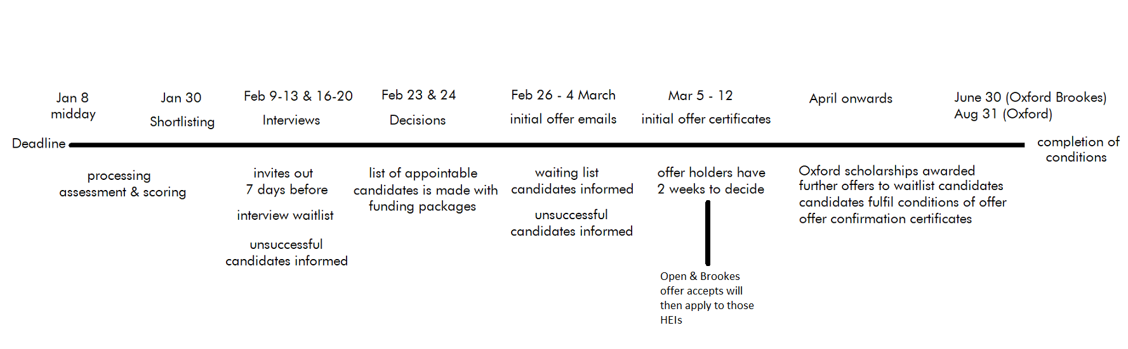
process timeline
Notes:
Key dates in the process are shown above the line, below the line are the behind the scenes processes. All applicants will be managed through the Oxford process until the time of offer, so that candidates will only be interviewed once, and will have their applications managed in exactly the same way, for consistency.
At the point where offers are made, and accepted, then those candidates only will apply to our fellow HEIs, and from that point onwards will be managed by the admissions process of Open and Brookes.

Slide 17
Questions?

